Slide 2
Module 3
Towards RE and CE through sectoral strategies in India

Slide 3
Course overview
Basic modules
1
Introductory session
2
Foundations of RE and CE in the international context
3
Towards RE and CE through sectoral strategies in India
Applied and advanced modules
4
Tools, standards and indicators for RE and CE
4a
Material Flow Analysis
4b
RE and CE Indicators
4c
Alternative Materials & Technologies
4d
Greening the Supply Chain
Recap and evaluation
5
Summary, outlook and evaluation

Slide 4
Learning objective: module 3
After completion of module 3, participants will be able to
contextualize challenges and opportunities of RE and CE in India;
outline the existing policy context along the automotive value chain;
capture the key elements of the RE strategy and four sectoral strategy papers; and
map out the stakeholders involved in the implementation of sectoral strategies at the national level.

Slide 5
RE and CE: challenges and opportunities in India
Trainer guidance: 30 mins, 7 slides
Introduce task to participants and show video on RE in India; afterwards, harvest ideas and notes in plenary
Explain the implications of increasing material demand and dependence on critical raw materials; outline benefits of CE

Slide 6
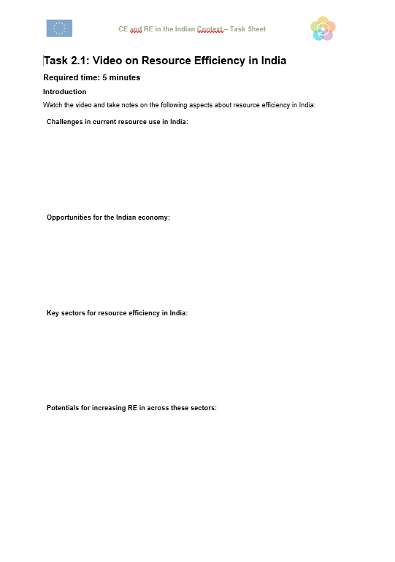
RE and CE: challenges and opportunities in India
Exercise 3.1: Video analysis
Watch the following video and take notes on the following aspects:
Challenges of current resource use in India
Opportunities for the Indian economy
Key sectors for increasing RE
Potentials for increasing RE in the automotive sector
Estimated time requirement: 5 min

Slide 7
RE and CE: challenges and opportunities in India
https://www.youtube.com/watch?v=gqhJ4IUhhak
Notes:
https://www.youtube.com/watch?v=gqhJ4IUhhak

Slide 8
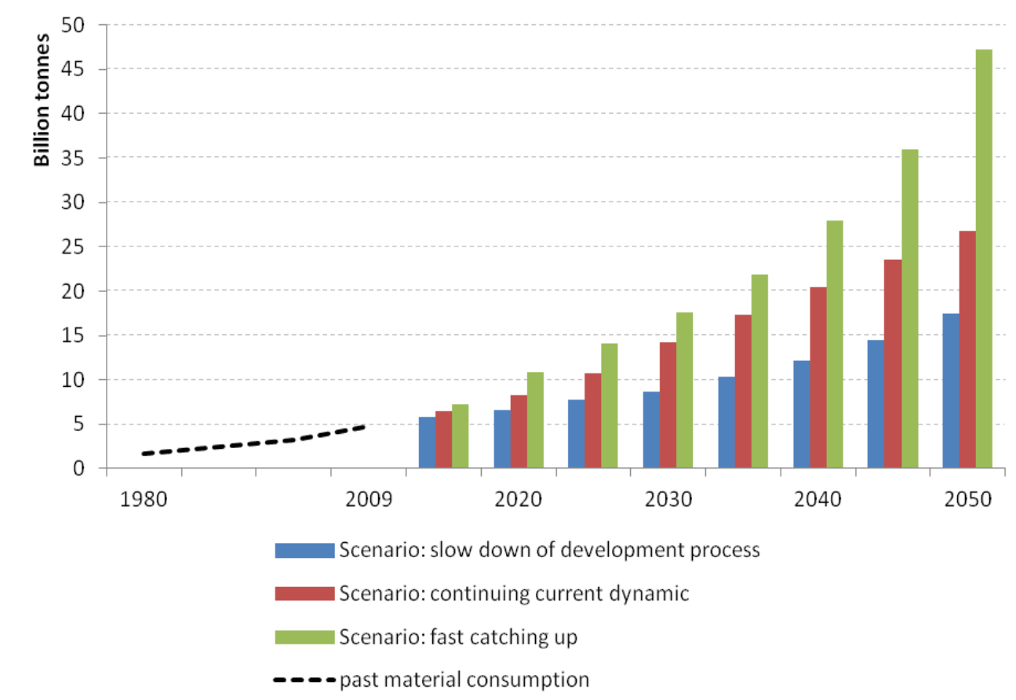
RE and CE: challenges and opportunities in India
India’s growing middle income class, urbanization and industrialization are major drivers of resource consumption.
Almost 1.4 billion people as of 2019; projected to overtake China and become the most populous country by 2027
Steady economic growth fuelled resource consumption: 1970 – 2015 saw a sixfold increase in annual material consumption, from 1.8 billion tonnes to 7 billion tonnes
India‘s raw material demand might increase tenfold by 2050. Without further actions, scarcity may create shocks to the Indian economy.
Picture source: https://www.iastoppers.com/pib-daily-27th-august-2019-iastoppers/
Notes:
https://www.ellenmacarthurfoundation.org/assets/downloads/publications/Circular-economy-in-India_5-Dec_2016.pdf

Slide 9
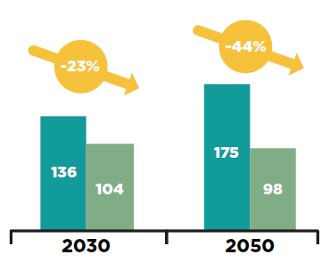
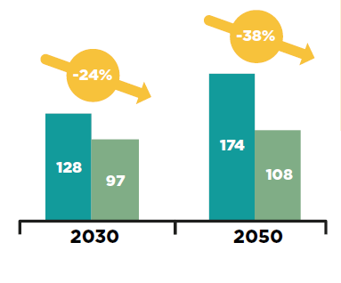
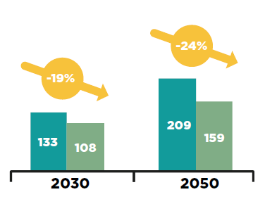
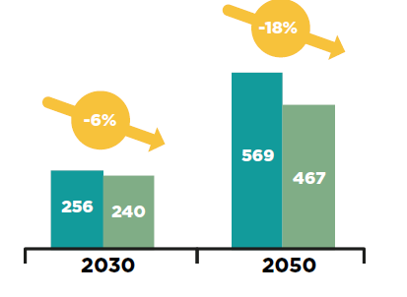
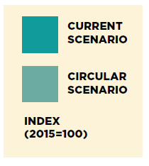
RE and CE: challenges and opportunities in India
“The usage of natural resources especially raw materials in the entire value chain - from extraction to end-of-life - leads to environmental threats like GHG emission, pollutants in various media viz. air, water and soil, and risks to ecology and biodiversity.”
- Indian RE Strategy
A circular economy development path could significantly mitigate negative environmental externalities.
Consumption of virgin non-renewable materials
Water usage in construction industry
Urban ground land used for commercial and residential buildings
GHG emissions
Potential impact scenarios of transition to CE in the ‘mobility and vehicle manufacturing’, ‘food and agriculture’ and ‘cities and construction’ sectors combined
Picture source: https://www.ellenmacarthurfoundation.org/assets/downloads/publications/Circular-economy-in-India_5-Dec_2016.pdf
Notes:
https://www.ellenmacarthurfoundation.org/assets/downloads/publications/Circular-economy-in-India_5-Dec_2016.pdf

Slide 10
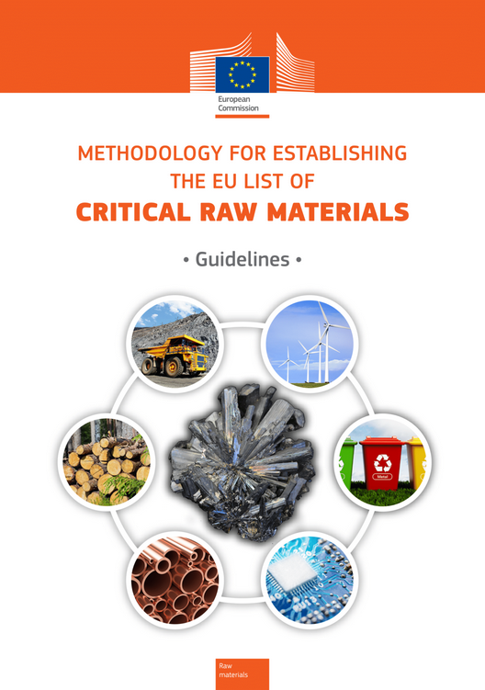
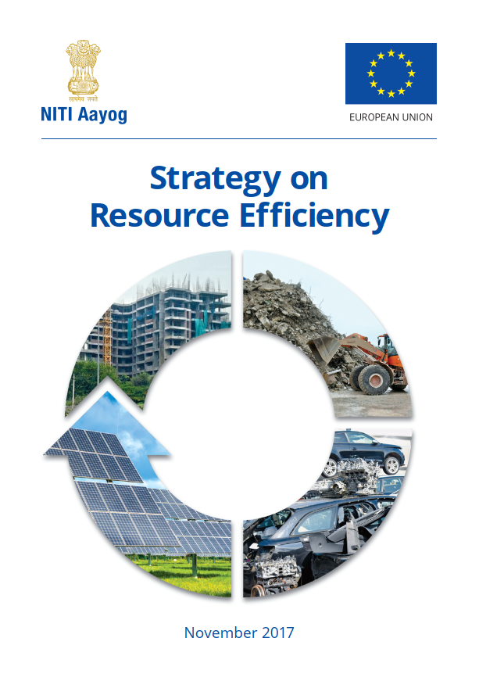
RE and CE: challenges and opportunities in India
How do we determine priority materials?
EU definition of “critical raw materials”:
Raw materials which are economically and strategically important for the European economy, but have a high risk associated with their supply
Economic importance, supply chain disruptions, price volatility, environmental issues
Parameters as per the Indian RE Strategy:
Economic importance of the material based on its usage across different sectors
Environmental impact due to extraction and production
Embodied energy
Supply risks determined through:
Limited geological availability and criticality
High import dependency for critical resources
Geopolitical constraints
Example: RHENIUM
super-alloys in aerospace & automotive industry→ high economic importance
India is 100% import dependent with no declared reserves
[1]
[2]
Picture sources: [1] https://op.europa.eu/en/publication-detail/-/publication/2d43b7e2-66ac-11e7-b2f2-01aa75ed71a1/language-en/format-PDF/source-32064602 [2] https://www.eu-rei.com/publications.html
Notes:
https://op.europa.eu/en/publication-detail/-/publication/2d43b7e2-66ac-11e7-b2f2-01aa75ed71a1/language-en/format-PDF/source-32064602

Slide 11
RE and CE: challenges and opportunities in India
Critical raw materials in the sector
New critical raw materials for electric cars
[2]
Notes:
https://op.europa.eu/en/publication-detail/-/publication/2d43b7e2-66ac-11e7-b2f2-01aa75ed71a1/language-en/format-PDF/source-32064602

Slide 12
RE and CE: challenges and opportunities in India
Critical raw materials (metals) in the automotive sector
Rhodium
Praseodymium
Dysprosium
Neodymium
Terbium
Europium
[2]
Picture sources: Canadian Mining
Notes:
https://op.europa.eu/en/publication-detail/-/publication/2d43b7e2-66ac-11e7-b2f2-01aa75ed71a1/language-en/format-PDF/source-32064602

Slide 13
RE and CE: challenges and opportunities in India
Critical raw materials in the automotive sector
Rhodium
Praseodymium
Dysprosium
Neodymium
Terbiu
Europium
The 6 most vulnerable metals in automotive production:
Are used in electric motors, automotive electronics, autocatalysts and LED lighting.
Are part of the EU’s 2017 list of 27 CRMs
Recycling and substitution are limited.
See high exposure to potential restrictions on supply (e.g. solely provided by China).
[2]
Source: https://ec.europa.eu/environment/integration/research/newsalert/pdf/new_approach_assessing_vulnerability_critical_raw_materials_automotive_industry_528na2_en.pdf
Notes:
https://op.europa.eu/en/publication-detail/-/publication/2d43b7e2-66ac-11e7-b2f2-01aa75ed71a1/language-en/format-PDF/source-32064602

Slide 14
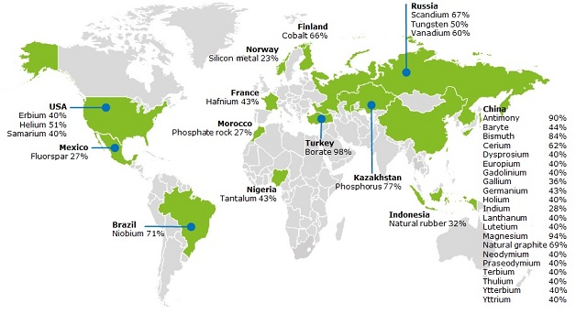
RE and CE: challenges and opportunities in India
Many countries are highly dependent on the import of critical raw materials.
[2]
[1]
Picture sources: [1] https://ec.europa.eu/growth/sectors/raw-materials/specific-interest/critical_en
[2] http://re.urban-industrial.in/live/hrdpmp/hrdpmaster/igep/content/e64918/e64922/e67075/e67084/DMS_GIZ_IREP_PolicyBrief.pdf
Notes:
https://ec.europa.eu/growth/sectors/raw-materials/specific-interest/critical_en

Slide 15
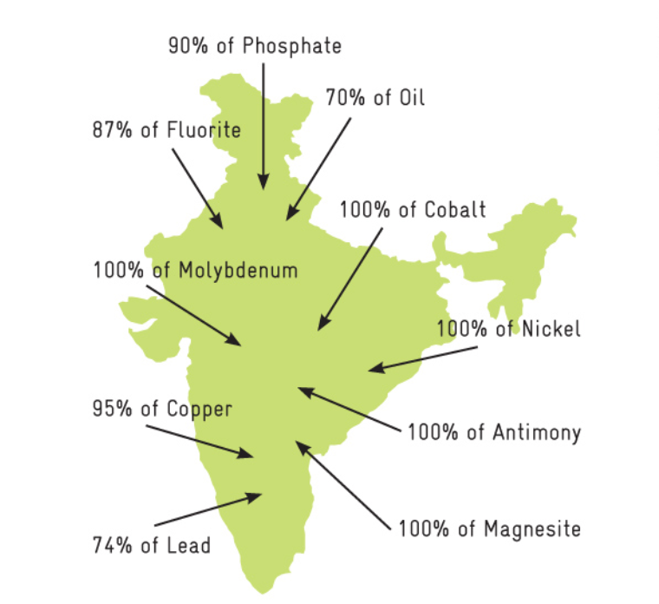
RE and CE: challenges and opportunities in India
Although 97% of India’s resources are produced domestically, it is also highly dependent on the import of critical raw materials.
Vehicle type | Priority materials | Import dependency
Internal Combustion Engine Vehicles | Steel, Copper, Aluminium, Zinc, Nickel, Lead, Glass Rubber, Plastics | Copper: 50-60% Lithium: 100% Cobalt: 100% Aluminium scrap: 90% Steel scrap: 20-25% Lead: 75% Rare Earths: 100%
E-Vehicles | Lithium, Cobalt, Nickel, Rare Earths, Plastics, Steel, Copper, Alumium
Picture sources: [1] https://ec.europa.eu/growth/sectors/raw-materials/specific-interest/critical_en
[2] http://re.urban-industrial.in/live/hrdpmp/hrdpmaster/igep/content/e64918/e64922/e67075/e67084/DMS_GIZ_IREP_PolicyBrief.pdf
Notes:
https://ec.europa.eu/growth/sectors/raw-materials/specific-interest/critical_en
http://moef.gov.in/wp-content/uploads/2019/07/Draft-National-Resourc.pdf
India exports: Iron and steel, and iron ore
https://www.isas.nus.edu.sg/papers/indias-industrial-raw-material-and-food-exports-emergence-of-china-as-important-and-distinct-market/#:~:text=While%20iron%20and%20steel%20exports,per%20cent%20of%20iron%20ore.

Slide 16
RE and CE: challenges and opportunities in India
How to determine the level of “criticality” of a resource
Usage across the manufacturing sectors as measured by value addition
Economic importance
Criticality
Geopolitical risk associated with trade in that resource
Supply risk
Domestic endowment of the resource
!
Even if a mineral is used in small quantities, in a high-value-added manufacturing sector it can be more critical as compared to a mineral used in large quantities in a low-value-added manufacturing sector
Potential share of the recycled mineral in the primary manufacturing of products
Level of substitutability at the end-use application
Notes:
https://dst.gov.in/sites/default/files/CEEW_0.pdf

Slide 17
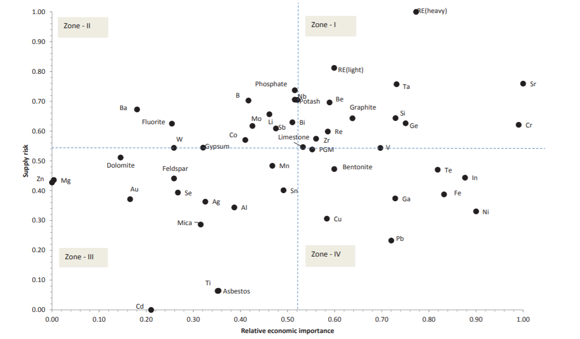
RE and CE: challenges and opportunities in India
Critical minerals for 2030 regarding the Indian manufacturing sector
Picture source: https://dst.gov.in/sites/default/files/CEEW_0.pdf
Notes:
Source: Department of Science & Technology, GoI https://dst.gov.in/sites/default/files/CEEW_0.pdf

Slide 18
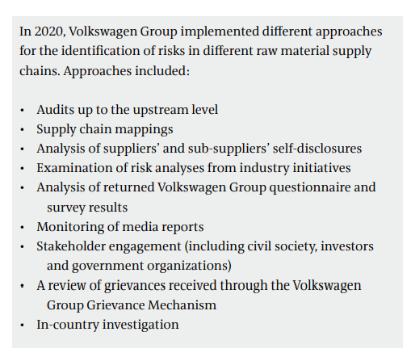
RE and CE: challenges and opportunities in India
Case study: Volkswagen Material Risk Assessment
Notes:
https://www.volkswagenag.com/presence/nachhaltigkeit/documents/supply-chain/Volkswagen_Group_Responsible_Raw_Materials_Report_2020.pdf

Slide 19
Strategies on RE and CE across selected sectors in India
Exercise 3.2: Critical resources in the sector
Form groups
Read one of the news articles of 2021.
Collect information of the effects of the global chip shortage
Discuss the findings and guiding questions with the group
Estimated time requirement: 20 min
Notes:
Picture: https://autovista24.autovistagroup.com/news/chip-shortage-limits-recovery-of-eu-new-car-markets-in-september/

Slide 20
RE and CE: challenges and opportunities in India
Economic benefits of CE and RE
Development of CE and RE in India could create annual value of ₹14 lakh crore (US$ 218 billion) in 2030.
Secure long-term material needs and increase resilience of Indian economy.
Businesses could achieve material cost savings and increase their profit.
Making use of digital technology to enable CE could reinforce India’s position as a hub for technology and innovation.
Example: Vehicles as service
New revenue stream for automotive industry
Increased utility (in terms of total km driven) & decreased running costs
more intensive use of each car
easier maintenance and boosted fuel efficiency through innovative vehicle design
Notes:
https://www.ellenmacarthurfoundation.org/assets/downloads/publications/Circular-economy-in-India_5-Dec_2016.pdf

Slide 21
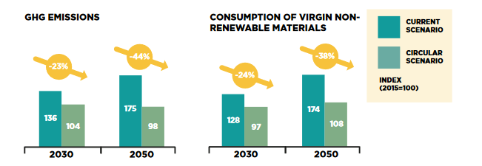
RE and CE: challenges and opportunities in India
Environmental and social benefits of RE and CE
A circular economy development path could significantly mitigate negative environmental externalities.
Cheaper products and services for India`s population while reducing congestion and pollution
Picture source: https://www.ellenmacarthurfoundation.org/assets/downloads/publications/Circular-economy-in-India_5-Dec_2016.pdf
Notes:
https://www.ellenmacarthurfoundation.org/assets/downloads/publications/Circular-economy-in-India_5-Dec_2016.pdf

Slide 22
National progress on RE and CE
Trainer guidance: 20 mins, 11 slides
Show graph on biocapacity and Human Development Index; highlight path towards sustainable development quadrant;
Outline India’s performance on SDGs; emphasize the lack of information on SDG 12 (SCP)
Present Indian policies and programmes along the lifecycle stages

Slide 23
National progress on RE and CE
Top and bottom 10 countries on HDI and Ecological Footprint
Global resource budget
World Biocapacity in 1961
World Biocapacity in 2012
Picture source: https://www.footprintnetwork.org/2016/07/20/measure-sustainable-development-two-new-indeces-two-different-views (adapted)
Notes:
https://www.footprintnetwork.org/2016/07/20/measure-sustainable-development-two-new-indeces-two-different-views

Slide 24
National progress on RE and CE
Global Sustainable Development Quadrant
World Biocapacity in 1961
India
World Biocapacity in 2012
Picture source: https://www.footprintnetwork.org/2016/07/20/measure-sustainable-development-two-new-indeces-two-different-views (adapted)
Notes:
https://www.footprintnetwork.org/2016/07/20/measure-sustainable-development-two-new-indeces-two-different-views

Slide 25
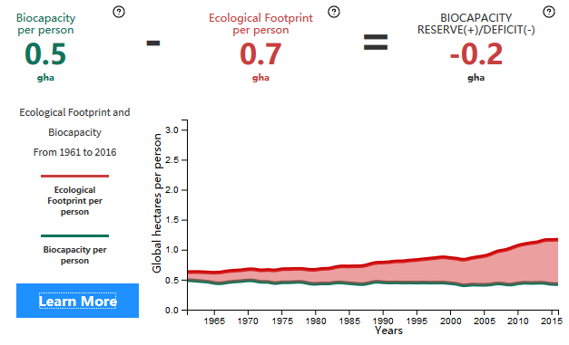
National progress on RE and CE
Countries must reduce both absolute and per capita consumption in order to move into the global sustainable development quadrant!
[2]
World Biocapacity in 1961
World Biocapacity in 2012
[1]
Picture sources: [1] https://www.footprintnetwork.org/2016/07/20/measure-sustainable-development-two-new-indeces-two-different-views (adapted) [2] http://data.footprintnetwork.org/?_ga=2.16269430.196531191.1573637476-527890571.1573637476#/
Notes:
https://www.footprintnetwork.org/2016/07/20/measure-sustainable-development-two-new-indeces-two-different-views
http://data.footprintnetwork.org/?_ga=2.16269430.196531191.1573637476-527890571.1573637476#/

Slide 26
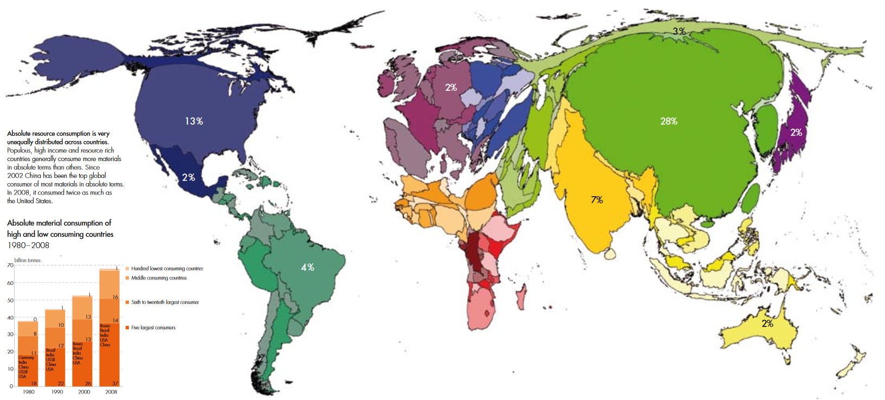
National progress on RE and CE
Globally, the “big five” material consuming countries – China, the United States, India, Brazil and Russia – are responsible for 55% of total material requirement.
Absolute material consumption of countries and share in global material consumption in 2008
Country size is proportional to its share in global material consumption
Picture source: https://www.boell.de/sites/default/files/201207_green_economies_around_the_world.pdf
Notes:
https://www.boell.de/sites/default/files/201207_green_economies_around_the_world.pdf

Slide 27
National progress on RE and CE
Find out what your personal Ecological Footprint is at:
https://www.footprintcalculator.org/
Picture source: https://www.footprintcalculator.org/

Slide 28
Sectoral progress on RE and CE
Lifecycle Ghg emissions of a car in Europe and India
Picture source: https://www.footprintcalculator.org/
Notes:
https://fslci.org/news/news-type/press-release/2021/07/a-global-comparison-of-life-cycle-ghg-emissions-from-passenger-cars-new-lca-study-by-icct/

Slide 29
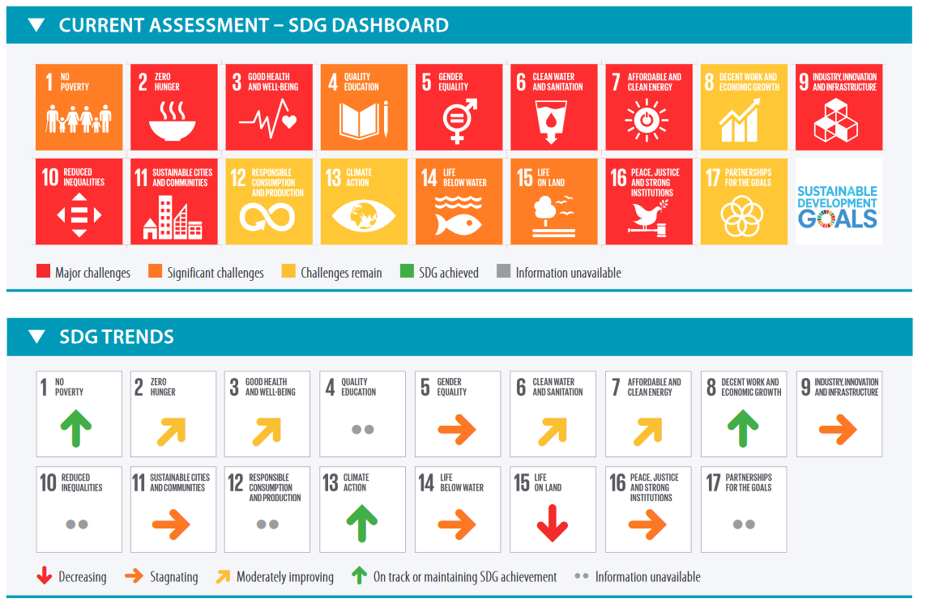
National progress on RE and CE
India’s Performance on the SGDs: making progress, but acute lack of data on SDG 12.
Intervention and support by EU-REI project
Picture source: https://s3.amazonaws.com/sustainabledevelopment.report/2019/2019_sustainable_development_report.pdf
Notes:
Picture source: https://s3.amazonaws.com/sustainabledevelopment.report/2019/2019_sustainable_development_report.pdf
Current assessment of India’s Performance on its transformation to achieve the SGDs
Based on the Sustainable Development Report 2019
Indicated are the SGDs where CE can have a positive impact, as it was shown in Module1

Slide 30
National progress on RE and CE
Current policies and legislations in India seek to create change across various lifecycle stages
Resource extraction
Design
Production/ Manufacturing
Consumption
End of life

Slide 31
National progress on RE and CE
Resource extraction
Design
Production/ Manufacturing
Consumption
End of life
National Mining Policy, 2008:
New draft 2018
Zero-waste mining
Upgradation of mining technology for efficient extraction
Steel Policy, 2017:
Increase in extraction rates
Higher efficiency to reduce environmental impacts
National Mineral Policy, 2019

Slide 32
National progress on RE and CE
Resource extraction
Design
Production/ Manufacturing
Consumption
End of life
India RoHS restricts the same six substances at the same maximum concentrations as in the EU, just the scope of products differ
National Housing and Habitat Policy, 2007
Ecological design standards for building components, materials and construction methods
National Design Policy, 2007
Eco-friendliness, ecology and sustainability as key criteria for the India Design Mark (I Mark)
E-Waste (Management and Handling) Rules, 2016
Restricts usage of certain hazardous substances in electrical and electronics equipment
Ecomark issued by the Bureau of Indian Standards

Slide 33
National progress on RE and CE
Resource extraction
Design
Production/ Manufacturing
Consumption
End of life
Make in India, 2014:
Increase in energy and water efficiency and pollution control technologies through Technology Acquisition and Development Fund (TADF)
National Manufacturing Policy, 2012:
Use of clean and efficient technology

Slide 34
National progress on RE and CE
Resource extraction
Design
Production/ Manufacturing
Consumption
End of life
No comprehensive legislation for (green) public procurement; however, guided by other central legislations, e.g.
Contract Act 1872
Sale of Goods Act 1930
Prevention of Corruption Act 1988
Arbitration and Conciliation Act 1996
Task Force on Sustainable Public Procurement set up by Ministry of Finance in 2018

Slide 35
National progress on RE and CE
Resource extraction
Design
Production/Manufacturing
Consumption
End of life
Clean India Mission (Swach Bharat):
Overarching programme for sanitation and waste management
Legislations protecting the environment, human health and ensuring sound management of waste streams, in part incorporating on Extended Producer Responsibility (EPR):
Solid Waste Management Rules, 2016
E-waste Management & Handling Rules, 2016
Plastic Waste Management Rules, 2016
Batteries (Management and Handling) Rules, 2001 (and subsequent amendments)
Construction and Demolition Waste Management and Handling Rules, 2016 (no EPR)
Steel Scrap Recycling Policy, 2019 (no EPR)

Slide 36
National progress on RE and CE
Important legislative development of automotive sector in India:
National Automobile Scrappage Policy
Fame India Scheme
Automotive Mission Plan 2016-26 (AMP 2026)
Draft National Automotive Policy 2018National Automotive Testing and R&D Infrastructure Project (NATRIP)
National Electric Mobility Mission Plan 2020 (NEMMP)
Production Linked Incentive (PLI) Scheme
Notes:
https://www.makeinindia.com/sector/automobiles

Slide 37
National progress on RE and CE
National Automobile Scrappage Policy
creating an ecosystem for phasing out old unsafe, polluting vehicles and replacing them with newer safe and fuel-efficient vehicles.
Helping to increase Automobile sales, provide employment, reduce import costs, generate incremental GST revenue and help to solve the global shortage of semiconductor chip.
providing an important link in creating a circular economy (waste to wealth) for the country.
Notes:
https://www.makeinindia.com/sector/automobiles

Slide 38
National progress on RE and CE
4. Draft National Automotive Policy 201832
Formulated by the department of Heavy Industries for the holistic development of the Automobile industry in India.
Scale up exports to 35-40% of the overall output
The following propositions are made in the policy:
Adopt a long-term roadmap for emission standards beyond BSVI and complement the same with the global standards by 2028.
Rollout CAFÉ (Corporate Average Fuel Efficiency) norms till 2025.
Adoption of a differential taxation method based on a composite criterion, including parameters such as CO2 emissions and length.
Associate AIS and BIS standards on safety-critical parts over the next 3 years.
Fast track adoption of Bharat New Vehicle Safety Assessment Program.
Notes:
https://www.makeinindia.com/sector/automobiles

Slide 39
National progress on RE and CE
5. National Electric Mobility Mission Plan 2020 (NEMMP)
Encourage consistent, affordable and competent xEVs (hybrid and electric vehicles) that meet consumer performance and price expectations through government-industry collaboration.
Promotion and development of indigenous manufacturing capabilities, required infrastructure, consumer awareness and technology
Gradually ensuring a vehicle population of about 6-7 mn electric/hybrid vehicles in India by the year 2020 along with a certain level of indigenization of technology
Notes:
https://www.makeinindia.com/sector/automobiles

Slide 40
Strategies on RE and CE across selected sectors in India
Trainer guidance: 30 mins, 5 slides
Outline development of RE strategy, sectoral strategy papers and draft RE policy in India
Explain contents of RE strategy and show structure of action plan
Highlight how action plan interlinks with sector specific strategies for implementation

Slide 41
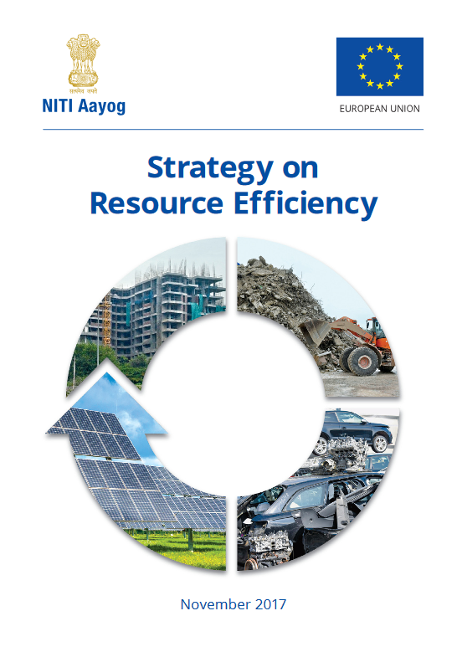
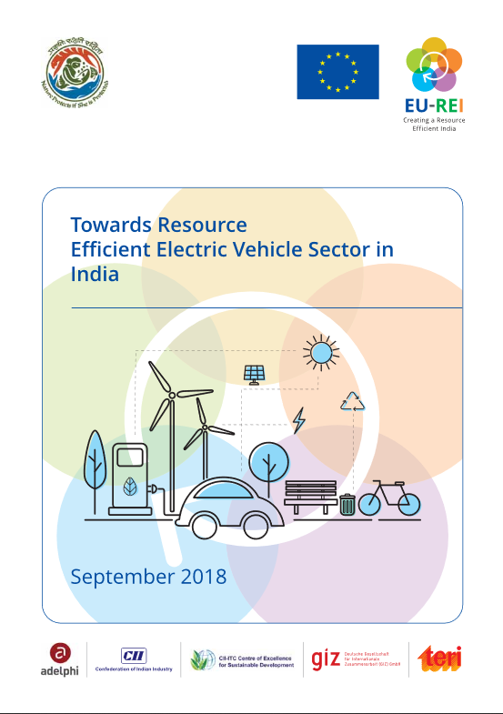
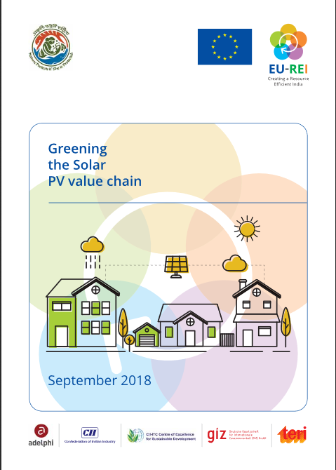
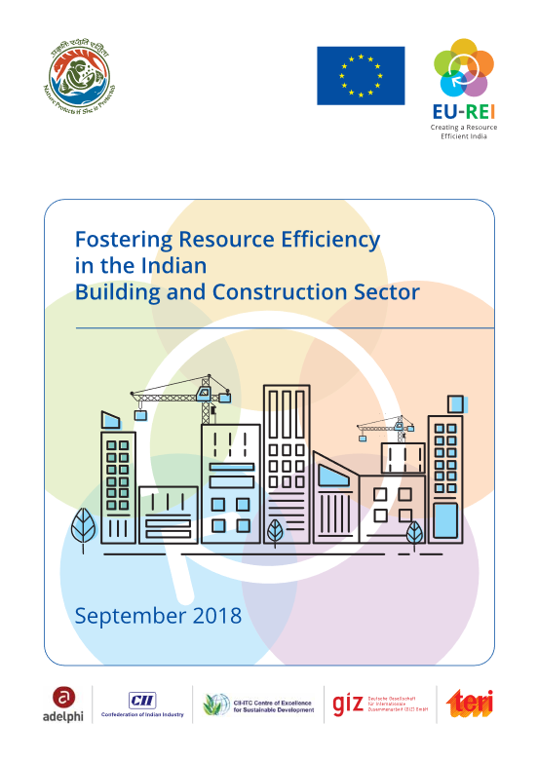
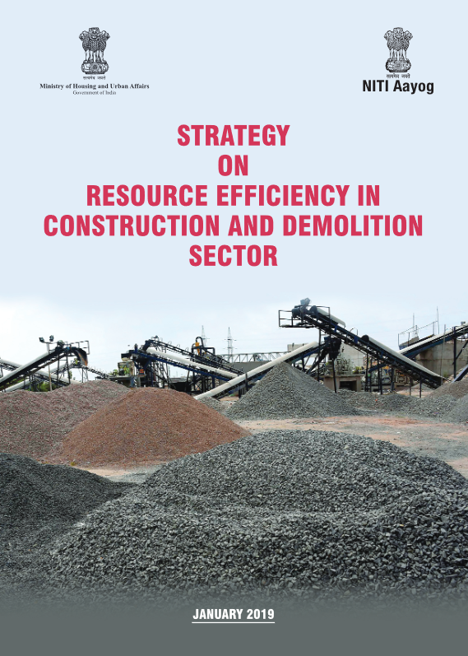
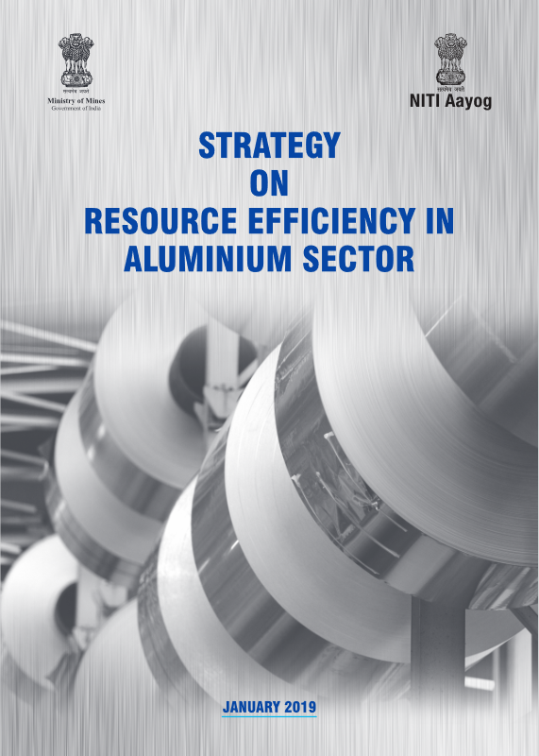
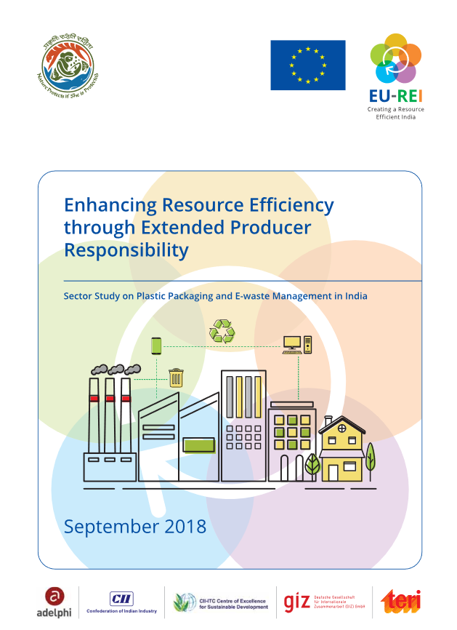
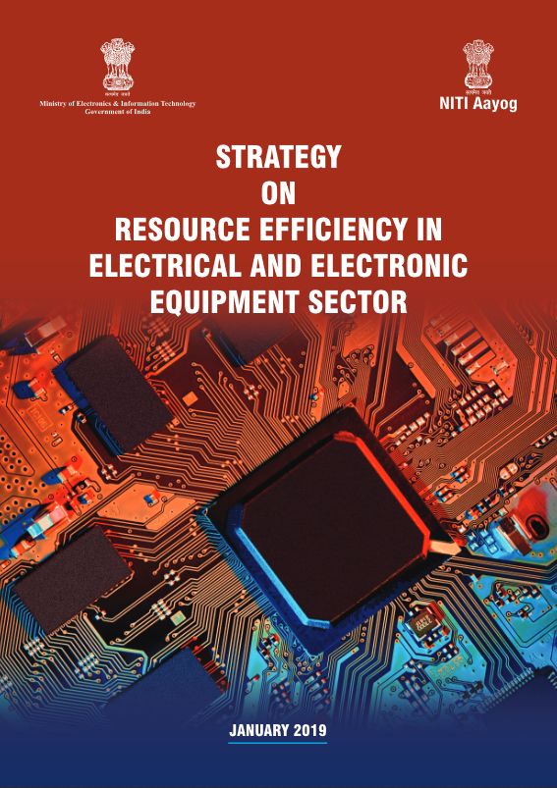
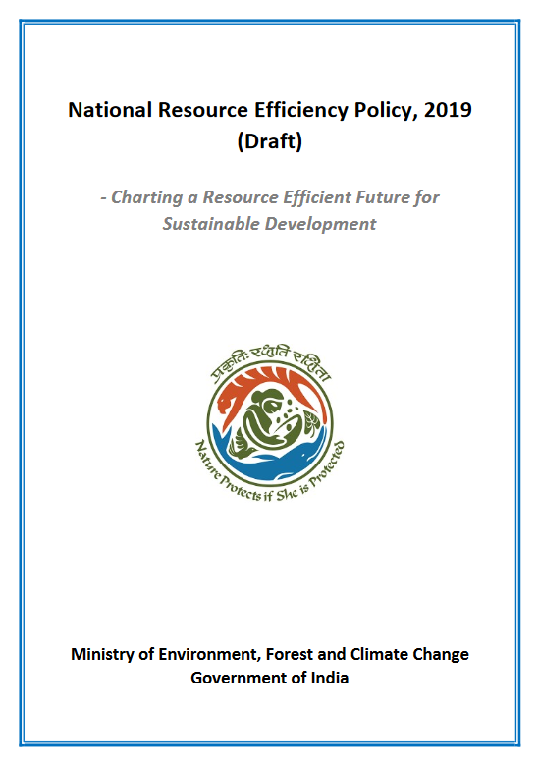
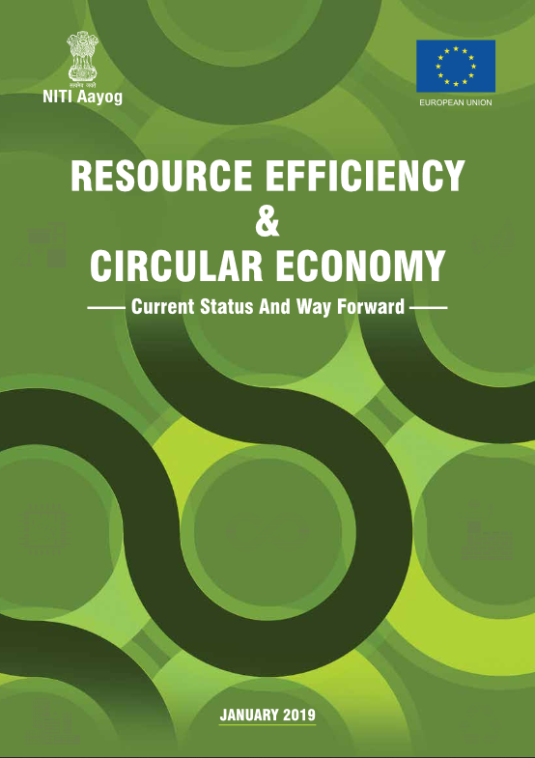
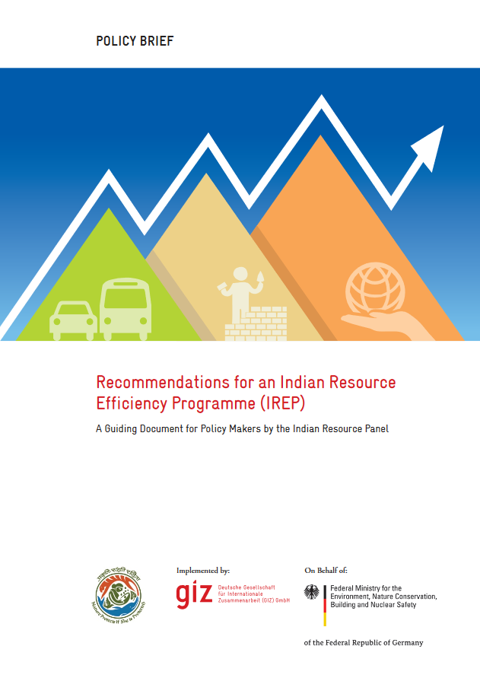
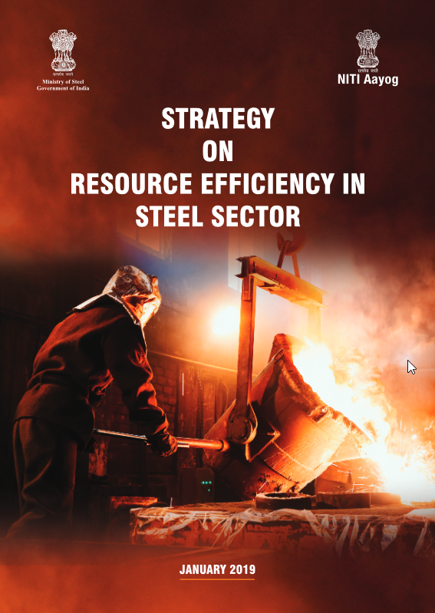
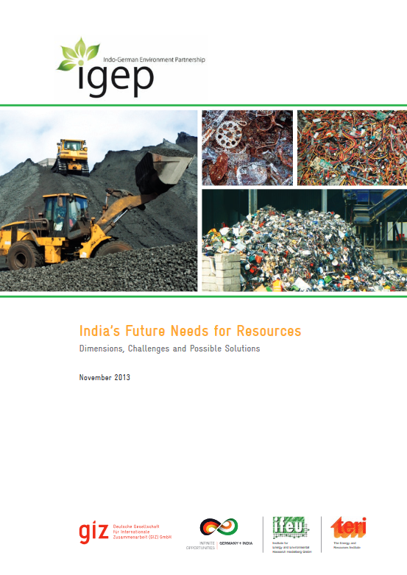
Strategies on RE and CE across selected sectors in India
2017
2019
Picture source: http://www.eu-rei.com/publications.html
2018
2014 - 2017
Notes:
http://www.eu-rei.com/publications.html
Strategy on Resource Efficiency, 2017
Strategy on Resource Efficiency in Aluminum Sector, 2019
Strategy on Resource Efficiency in Steel Sector, 2019
Strategy on Resource Efficiency in Electrical & Electronic Equipment Sector, 2019
Strategy on Resource Efficiency in Construction & Demolition Sector, 2019
Resource Efficiency & Circular Economy – Current Status and Way Forward, 2019

Slide 42
Strategies on RE and CE across selected sectors in India
Year | Name | Actors
2014 | BMZ-funded project on formation of InRP | MoEF&CC, BMZ Germany
2017 | Strategy on Resource Efficiency | NITI Aayog, EU-REI
2018 | Sectoral studies on RE and CE: Electric Vehicles Solar PV Building and Construction EPR for E-waste and Plastic Packaging | Ministry of Environment, Forests and Climate Change, EU-REI
 | Strategy on Resource Efficiency in Aluminum Sector | Ministry of Mines, NITI Aayog, EU-REI
 | Strategy on Resource Efficiency in Steel Sector | Ministry of Steel, NITI Aayog, EU-REI
 | Strategy on Resource Efficiency in the Electrical and Electronic Equipment Sector | Ministry of Electronics and Information Technology, NITI Aayog, EU-REI
 | Strategy on Resource Efficiency in Construction & Demolition Sector | Ministry of Housing and Urban Affairs, NITI Aayog, EU-REI
 | Resource Efficiency & Circular Economy – Current Status and Way Forward | NITI Aayog, EU-REI
2019 | National Resource Efficiency Policy (Draft) | Ministry of Environment, Forests and Climate Change, EU-REI
Notes:
http://www.eu-rei.com/publications.html
Strategy on Resource Efficiency, 2017
Strategy on Resource Efficiency in Aluminum Sector, 2019
Strategy on Resource Efficiency in Steel Sector, 2019
Strategy on Resource Efficiency in Electrical & Electronic Equipment Sector, 2019
Strategy on Resource Efficiency in Construction & Demolition Sector, 2019
Resource Efficiency & Circular Economy – Current Status and Way Forward, 2019

Slide 43
Strategies on RE and CE across selected sectors in India
The Strategy for Resource Efficiency by NITI Aayog (2017) establishes a broad framework for enhancing RE in the Indian economy
Key recommendations addressing all lifecycle stages as well as cross-cutting issues:
Promotion: Eco-labelling, standards, technology development, green public procurement, industrial clusters, awareness
Regulation: economic instruments, viability gap funding, policy reforms across life cycle stages
Institutional development: capacity development, institutional set-up and strengthening, database and indicators, resource index as a part of economic survey
Picture source: http://www.eu-rei.com/publications.html
Notes:
http://www.eu-rei.com/publications.html

Slide 44
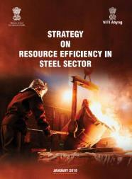
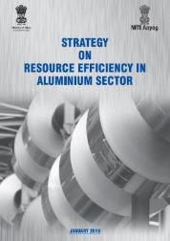
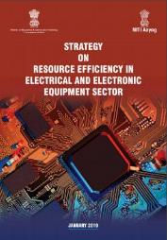
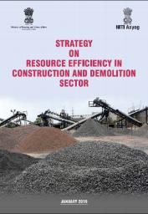
Strategies on RE and CE across selected sectors in India
NITI Aayog and Mo/Steel, Mo/Mines, MoHUA, MEITY release
Strategy on RE in Steel Sector
Strategy on RE in Aluminium Sector
Strategy on RE in EEE Sector
Strategy on RE in C&D Sector
Picture source: http://www.eu-rei.com/publications.html

Slide 45
Strategies on RE and CE across selected sectors in India
Trainer guidance: 75 mins, 5 slides
Ask participants to form 4 groups, introduce task and worksheets
Explain stakeholder mapping methodology
Provide some examples of stakeholders
Give participants 40 mins to work on the exercise
Harvest group-wise results
Summarise main take-away messages

Slide 46
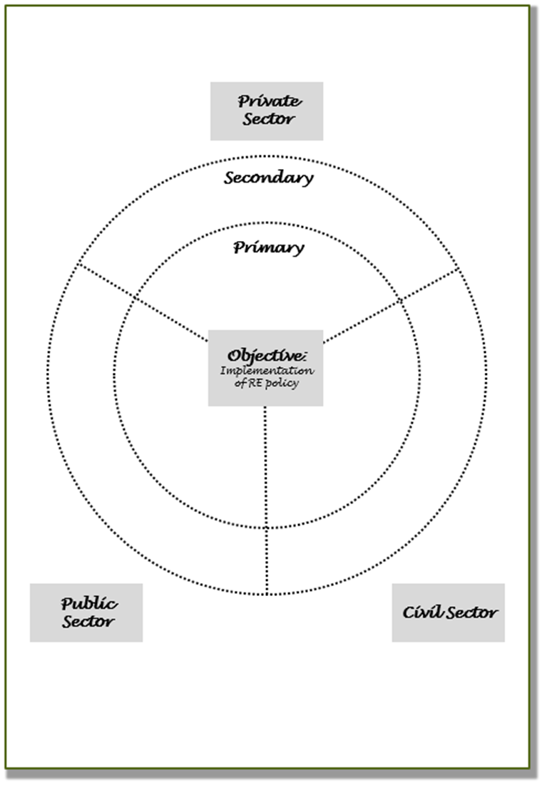
Strategies on RE and CE across selected sectors in India
Exercise 3.3: Identifying key stakeholders of India’s Resource Efficiency Strategy for the automotive sector
Form groups of 4-5 persons
Analyse the summary of India’s Resource Efficiency Strategy with respect to status, concerns and opportunities.
Identify and classify the key stakeholders in relation to the implementation of the strategy (objective) on the prepared flipchart.
Estimated time requirement: 55 min
Notes:
http://moef.gov.in/wp-content/uploads/2019/07/Draft-National-Resourc.pdf

Slide 47
Strategies on RE and CE across selected sectors in India
Methodology for classification:
Relevance
Primary
Secondary
Veto player
Stakeholders to be placed in corresponding circle. Veto players to be highlighted by .
Sector
Private
Public
Civil society
Stakeholders to be placed in corresponding area.
Relationship
Strong
Weak
Relationships between stakeholders to be indicated by connecting them with lines.
All actors that are affected by the policy or have a potential stake in the action to be brought about by the policy are considered to be STAKEHOLDERS.
Primary actors: directly affected by the policy (i.e. will gain or lose power, privileges, etc. due to the implementation of the policy)
Secondary actors: involvement is temporary or indirect
Veto players: actors without whose support and participation the targeted result cannot be achieved
V
Notes:
Picture source: https://content.fortune.com/wp-content/uploads/2017/12/ibm01_a1.jpg

Slide 48
Strategies on RE and CE across selected sectors in India
Private sector
Secondary
stakeholders
Primary
stakeholders
Veto
stakeholders
Objective: implementation of strategy
Public sector
Civil Society

Slide 49
Summary
Take-home messages:
India’s growing middle income class, urbanization and industrialization are major drivers of resource consumption.
Although most resources are extracted domestically, India remains highly dependent on critical raw materials, which are important for its long-term development.
India has made important progress in moving towards the sustainable development quadrant by releasing overarching and sectoral strategies on RE and CE.
However, most strategies are yet to be implemented; this will require concerted efforts from various stakeholders in order to be successful.

