Slide 2
Module 5
Summary, outlook and evaluation

Slide 3
Course overview
Basic modules
1
Introductory session
2
Foundations of RE and CE in the international context
3
Towards RE and CE through sectoral strategies in India
Applied and advanced modules
4
Tools, standards and indicators for RE and CE
4a
Material Flow Analysis
4b
Life Cycle Assessment
4c
RE and CE Standards
4d
RE and CE Indicators
4e
Public Procurement
4f
Circular Business Models
4g
RE and CE Funding
Recap and evaluation
5
Summary, outlook and evaluation

Slide 4
Learning objective: module 5
After completion of module 5, participants will be able to
recall key concepts, background information, tools and standards presented throughout the course;
assess one’s learning progress and further learning needs; and
identify and use additional sources of information and reference.

Slide 5
Recall key concepts, background information, tools and standards
Trainer guidance: 30 mins, 1 slides
Present the slide with task 5.1 and explain the Card Roulette game the participants:
All participants standing or sitting in a circle would be optimal
Ask participants to draw out a card (include the trainer)
Everyone is asked to read out loud the question and try to answer it
If participants struggle give hints or ask the group for support. Take care, that everyone at least has the chance to articulate themselves
Please note that the required time for this exercise is depending on the number of participants and should be extended if needed

Slide 6
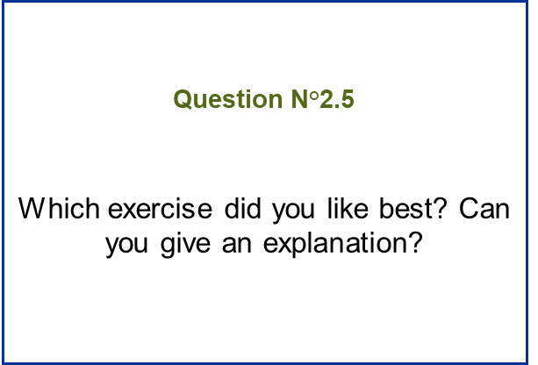
Recall key concepts, background information, tools and standards
Task 5.1: Card Roulette (Feedback Round)
Pick a card and read the question on the back out loud
Answer the question and/or discuss with your peers
Estimated time requirement: 30 min

Slide 7
Additional sources of information & references
Trainer guidance: 10 mins, 1 slide
Display slide on Additional sources of information & references and emphasise the resources available through the participants handbook

Slide 8
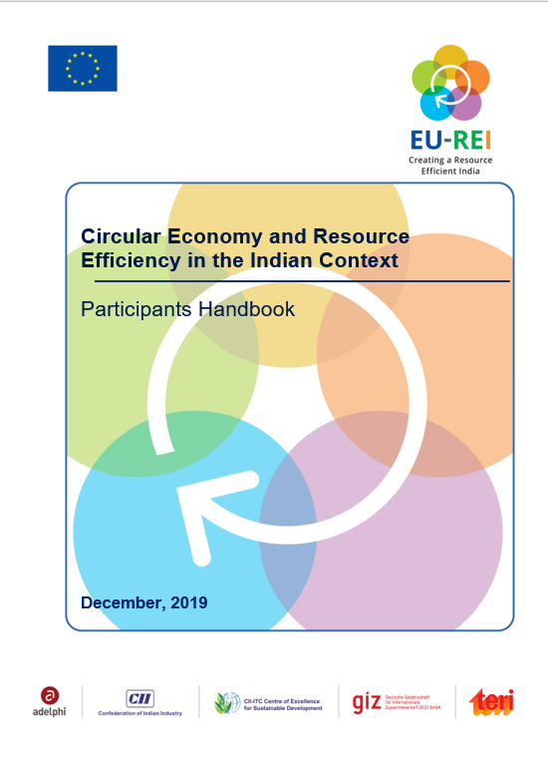
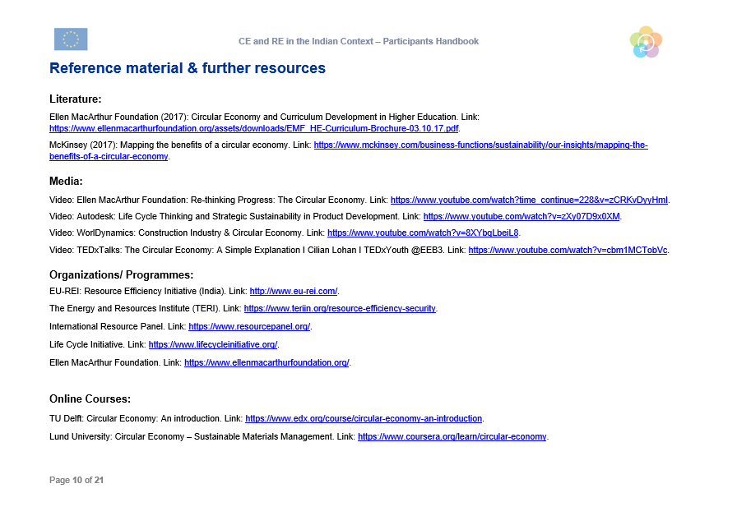
Additional sources of information & references
Background information on the presentations
Reference material & further resources: literature, media, organizations, programs, online courses

Slide 9
Assessing learning progress (optional)
Trainer guidance: 50 mins, 2 slides
Present the slide with task 5.2 and explain the three parts of the post- evaluation form to the participants
Briefly describe the purpose of pre- and post- assessment tests and their benefits to this programme
Ask participants to read the forms and answer any upcoming questions. Afterwards encourage participants to fill out the forms to their best knowledge.

Slide 10
Assessing learning progress
Pre- and Post- Assessments
Pre- Assessment
Instructions
Post- Assessment
Formative Evaluation
Lectures, exercises, assignments, activities
Summative Evaluation

Slide 11
Assessing learning progress
Task 5.2: Please fill out the post-assessment and the evaluation forms
Part 1: Post-assessment form
Part 2: Evaluation of content and methodology
Estimated time requirement: 20 min

