Slide 1






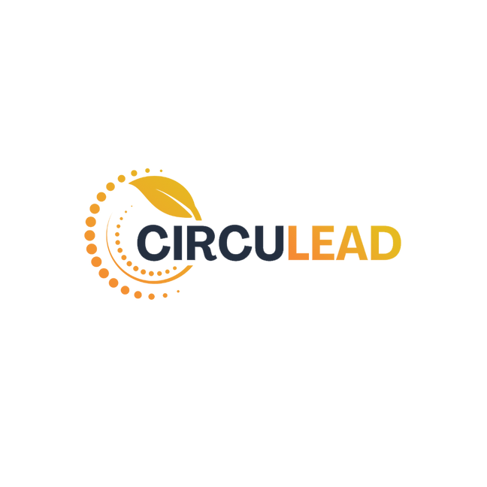




A Programme To Empower Women Leaders In Circular Economy Innovations
Presentation - 2023
Gender Mainstreaming in Circular Economy Business Models & Leadership Toolkit

Slide 2




2
About the EU-India Resource Efficiency &
Circular Economy
Supported by the European Union – Resource Efficiency Initiative (EU-REI)
The transition to a resource-efficient and circular economy is essential for the sustainability of EU and India’s economic growth and requires working together for a global systemic shift. At the 15th EU-India Summit in July 2020, the EU and India adopted a Joint Declaration to establish an ‘India-EU Resource Efficiency and Circular Economy Partnership.’ The objective of partnership is to support and strengthen dialogue and cooperation on resource efficiency and circular economy by bringing together representatives of relevant stakeholders from both sides, including governments, businesses (including start-ups), academia and research institutes. EU’s Resource Efficiency Initiative acts as an important vehicle for taking forward the partnership.
Consortium
The European Union – Resource Efficiency Initiative (EU-REI) is implemented on behalf of the European Union by a consortium led by the Deutsche Gesellschaft für Internationale Zusammenarbeit (GIZ) GmbH with The Energy and Resources Institute (TERI), Confederation of the Indian Industry (CII) and Adelphi. The EU-REI aims to facilitate partnerships between Indian and European businesses and stakeholders on Resource Efficiency (RE) and Circular Economy in sectors of interest.
Supported by

Slide 3

About CircuLead
CircuLead is a 6-week programme designed to empower women entrepreneurs building innovative solutions in the Resource Efficiency (RE) or Circular Economy (CE) sectors. The programme aims to support women leaders to strengthen their business models, deepen their leadership skills and learn from peers through a hybrid, immersive learning experience. The EU-Resource Efficiency Initiative (EU-REI) is implementing this training programme with support from Nüshu Network, powered by Unlock Impact.
About Nüshu Network
Nüshu Network offers community, coaching, and capital for women entrepreneurs in Asia who are looking to build and grow sustainable enterprises. We believe women-led businesses build for long-term change and are an integral part of equitable economies. Since our inception, we have delivered 2000+ hours of learning, 1000+ hours of mentoring at 50+ community events to over 500+ women entrepreneurs.
Nüshu Network is an initiative from Unlock Impact, a firm dedicated to help purpose-driven enterprises succeed.
3

Slide 4
About The Assignment
This toolkit is made possible through the EU REI assignment on "Support to Gender Mainstreaming with Incorporation of Tools on Circular Entrepreneurship" . The assignment’s main objective is to develop tools on Circular Entrepreneurship for its incorporation in the RE and CE Gender Toolkit, and to undertake the training for modules during the RE and CE Gender Training with cohort of 8-15 women entrepreneurs and innovators as part of the CircuLead programme.
Identification and Selection of Women-Led and Women-Centric CE Innovations/Enterprises in India:
  Identifying and choosing CE businesses that are led by women or are significantly women-centric.
  Ensuring diversity in the selection to represent various aspects of Circular Entrepreneurship.
  Documenting Innovations/Enterprises:
  Creating short videos or stories that effectively showcase the chosen women-led and women-centric innovations and enterprises.
  and skills needed for Circular Entrepreneurship and gender mainstreaming.
  Fostering a supportive and collabHighlighting the unique aspects and success stories of these businesses.
  Designing and Developing Circular Economy and Gender Mainstreaming Toolkit:
  Developing a comprehensive toolkit that combines Circular Economy and Gender Mainstreaming.
  Providing resources, guidelines, and best practices to support the integration of gender considerations in CE enterprises.
  Training Women Innovators/Entrepreneurial Enthusiasts:
  Conducting training sessions for a cohort of 8-15 women entrepreneurs and innovators.
  Equipping them with the knowledge orative learning environment.
  Drafting Recommendations and Way Forward:
  Collecting insights and feedback from the training cohort.
  Formulating recommendations for improving gender mainstreaming in Circular Economy enterprises.
  Outlining a strategic roadmap for the future development and growth of gender-inclusive Circular Entrepreneurship in India.
  Conclusion: The EU REI assignment aims to empower women in the Circular Economy sector in India through the development of tools, training, and documentation of successful women-led and women-centric CE innovations and enterprises. This initiative not only supports gender mainstreaming but also contributes to the growth and sustainability of Circular Entrepreneurship in the region.
4

Slide 5
About the Toolkit: Circular Economy Business Model Tools
The Circular Economy Business Model Toolkit is a comprehensive resource designed to empower women innovators and startups in understanding and implementing circular economy principles. It equips them with the necessary knowledge and tools to assess their business models from a circularity perspective, emphasizing the triple bottom line impact (economic, environmental, and social). This toolkit includes the following essential tools:
Value Proposition Building:
    This tool assists startups in crafting a clear and compelling value proposition that aligns with circular economy principles.
    It helps identify unique selling points related to sustainability and resource efficiency.
    Circular Economy Compass:
    The Circular Economy Compass provides a strategic framework for startups to navigate their journey towards circularity.
    It guides entrepreneurs in identifying opportunities for resource optimization, waste reduction, and closed-loop systems.
    Circularity Intensifier:
    The Circularity Intensifier tool helps startups intensify their circularity efforts by identifying areas where they can enhance resource efficiency and reduce waste.
    It suggests strategies to move from a linear to a circular business model.
    Understanding Impact:
    Understanding the impact of a circular business model is crucial. This tool assists in quantifying and assessing the environmental and social impacts of a startup's operations.
    It helps in making data-driven decisions to improve sustainability.
    Enterprise Pitching:
    Effective communication is key to success. This tool helps startups develop pitches and presentations that effectively convey their circular economy business model.
    It highlights the environmental and social benefits, making it appealing to investors and customers.
    TIPS: To maximize the benefits of these tools, it is advisable for startups to engage their team members from different departments in the process. Collaborative efforts ensure a holistic understanding and application of circular economy principles within the organization.
This is to acknowledge the support of SEED (www.seed.uno) and Circular Economy Catalyst (www.thecircularcatalyst.com) project implemented by adelphi, Germany in designing and development of these circular economy business model tools.
5

Slide 6
About the Toolkit: Circular Economy Business Model Tools
The Circular Economy Business Model Toolkit is a comprehensive resource designed to empower women innovators and startups in understanding and implementing circular economy principles. It equips them with the necessary knowledge and tools to assess their business models from a circularity perspective, emphasizing the triple bottom line impact (economic, environmental, and social). This toolkit includes the following essential tools:
Value Proposition Building:
    This tool assists startups in crafting a clear and compelling value proposition that aligns with circular economy principles.
    It helps identify unique selling points related to sustainability and resource efficiency.
    Circular Economy Compass:
    The Circular Economy Compass provides a strategic framework for startups to navigate their journey towards circularity.
    It guides entrepreneurs in identifying opportunities for resource optimization, waste reduction, and closed-loop systems.
    Circularity Intensifier:
    The Circularity Intensifier tool helps startups intensify their circularity efforts by identifying areas where they can enhance resource efficiency and reduce waste.
    It suggests strategies to move from a linear to a circular business model.
    Understanding Impact:
    Understanding the impact of a circular business model is crucial. This tool assists in quantifying and assessing the environmental and social impacts of a startup's operations.
    It helps in making data-driven decisions to improve sustainability.
    Enterprise Pitching:
    Effective communication is key to success. This tool helps startups develop pitches and presentations that effectively convey their circular economy business model.
    It highlights the environmental and social benefits, making it appealing to investors and customers.
    TIPS: To maximize the benefits of these tools, it is advisable for startups to engage their team members from different departments in the process. Collaborative efforts ensure a holistic understanding and application of circular economy principles within the organization.
This is to acknowledge the support of SEED (www.seed.uno) and Circular Economy Catalyst (www.thecircularcatalyst.com) project implemented by adelphi, Germany in designing and development of these circular economy business model tools.
5

Slide 7
About the Toolkit: Gender & Leadership Modules
The CircuLead programme offers a comprehensive approach to empowering women in the world of business. Through a series of video modules and reflective exercises, it addresses key challenges faced by women entrepreneurs, such as Imposter Syndrome, building a strong company culture, investment readiness, and personal branding. The program's purpose is to provide women with the knowledge and tools needed to overcome these challenges, build self-confidence, create inclusive environments, navigate biases in fundraising, and establish a powerful personal brand. By equipping women with these essential skills and insights, the programme aims to promote their success, contributing to a more diverse and thriving entrepreneurial landscape.
  Imposter Syndrome: This module aims to provide women entrepreneurs with the necessary tools and knowledge to identify the triggers that initiate or intensify Imposter Syndrome. By challenging underlying self-beliefs and assumptions, Women Entrepreneurs can develop a stronger sense of self-worth and confidence in their abilities.
  Building a Strong Company Culture: Building a strong company culture is particularly relevant for women entrepreneurs as it creates an inclusive and supportive environment where they can thrive.
  Investment Readiness: To understand the basics of investment readiness and what it means for an early-stage business, and as a woman entrepreneur, how to navigate unconscious biases (or otherwise) by being prepared.
  Personal Branding: To guide women entrepreneurs in establishing their unique identity and credibility in the business world, fostering trust and influence.
  Pitch Perfect: Participants get an opportunity to strengthen their pitching skills in a mock pitch session with an expert panel and receive real-time feedback on their business model, investment ask and pitch deck. This is a safe space designed to help startup founders gain the confidence and skills needed to successfully pitch their business ideas and secure the funding they need to grow and succeed.
  Leadership Circle: The Leadership Circle provides a platform for leaders and founders to address the diverse challenges they encounter. From external issues like resource constraints and employee resistance to internal struggles such as self-doubt and impatience, the Leadership Circle supports individuals in navigating and overcoming these obstacles, allowing them to concentrate on their leadership journey.
Please note that the content in the video modules for Gender and Leadership Modules were originally developed for the SHELeads cohort as part of the GIZ Her&Now project in the year 2020, and have been adapted for the purpose of this training.
6

Slide 8
Table of Contents
Content | Pages
What is circular economy and Circular Economy-related Business Opportunities? | 8
Circular Business Examples | 14
CE TOOLS: Value Proposition Building | 16
CE TOOLS: Circular Economy Compass | 22
CE TOOLS: Circularity Intensifier | 27
CE TOOLS: Understanding Impact | 35
CE TOOLS: Enterprise Pitching | 44
Leadership Module: Imposter Syndrome | 51
Leadership Module: Building a Strong Company Culture | 70
Leadership Module: Personal Brand | 79
Leadership Module: Investment Readiness | 89
Leadership Circle | 108
7

Slide 9






What is Circular Economy?
A circular economy is a system that tries to get the most value of the resources we have by keeping them at their highest utility, for as long as we can (Ellen MacArthur Foundation 2022.
A circular economy is based on three principles: to eliminate waste and pollution, to circulate products and materials (at their highest value) and to regenerate nature (ibid).
How does circularity work? – let us look at nature
  Our economic system has to learn from nature. In nature, there is NO WASTE. The “waste” of one system becomes a resource for another. Everything is disassembled and reused. In nature, everything has a function without ever contaminating.
  Living organisms require a variety of nutrients and trace elements to sustain life. The nutrients from the soil are taken by a plant to grow. Plants become a source of food for herbivores, which at the same time are a feeding source for predators. If an organism dies, it becomes food for decomposers in the soil that transform the matter into new nutrients for new plants to grow. This process is known as a circular system, in which all matter continuously moves and transforms, but never turns to ‘waste’.
Decomposers
Plants
Matter
Herbivore
8

Slide 10


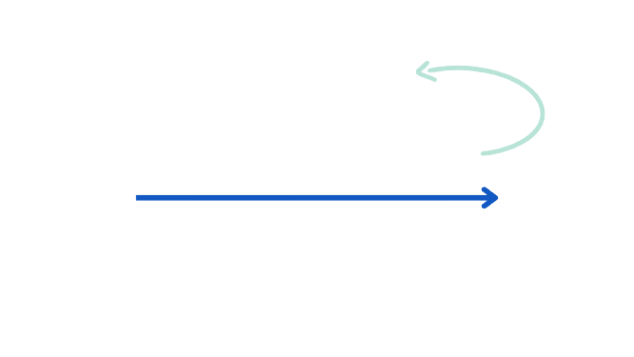




What is Circular Economy?
What happens with the product/service after it has been used?
  In our current economic system, WE DESIGN FOR USE,
  NOT TO RE-USE. This means that, unlike in nature, we live
  in a linear system of production and consumption.
  We take resources from nature to transform them
  into goods, use them and discard them, and by doing
  that, we generate immense amounts of waste.
  The most important pillar of circularity is to prevent
  products to NOT become ‘waste’ in the first place
  and to reuse what we call ‘waste’ through repairing,
  reusing, remanufacturing, recycling and sharing.
  Now, more than ever, it is crucial to adopt
  sustainable economic models to face and prevent
  global environmental degradation.
From a natural process
…to an economic system that embraces circularity
Turn waste into Resources or Energy and re-integrate it into the global value chains.
Take
Make
Use
Waste
Starts here
Ends here
9

Slide 11





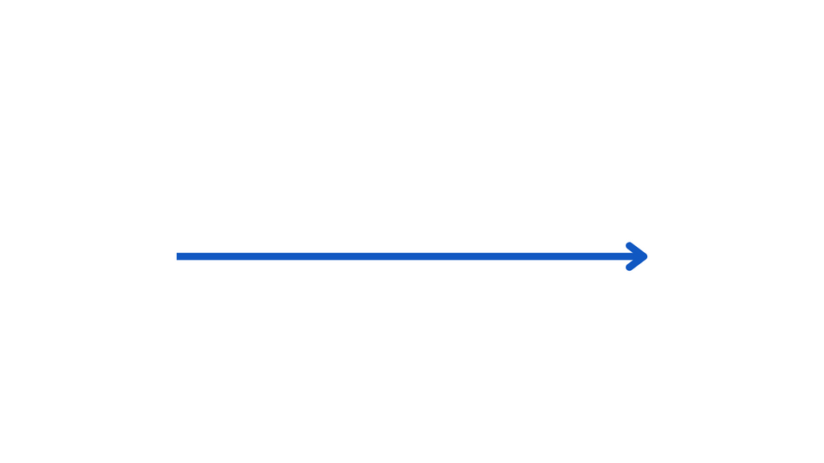


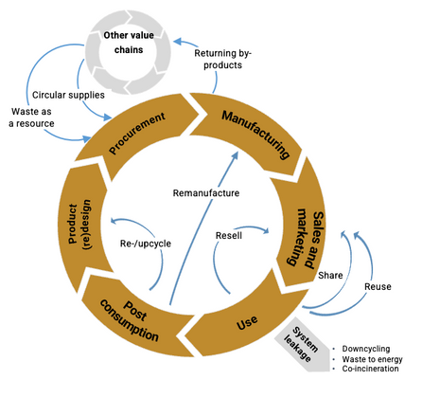
What is Circular Economy?
Linear versus circular system
What do our current and future economic systems look like?
  In linear economic system, Products are designed FOR USE, NOT RE-USE. By doing that, we consume enormous resources and generate immense amounts of waste.
  The Circular Economy is a model of production and consumption where existing products and materials are kept as long as possible in this system. The goal is to turn waste into Resources or Energy and re-integrate it into the global value chains.
  The circularity is to PREVENT products from becoming ‘waste’ by focusing on Refuse/Rethink/Redesign, Reduce and Reuse, Repair, Remanufacturing, Resell, Share, Recycling/Composting/Anaerobic digestion, and Recovery.
A linear system of production and consumption is equal to Take-make-discard: we take resources from nature, make goods from them, use them and discard them.
Take
Make
Use
Waste
Starts here
Ends here
A circular economy means rejecting the linear take-make-discard economy and adopting a regenerative model: using processes that restore, renew or revitalise their own sources of energy and materials and wasting as little as possible.
10

Slide 12
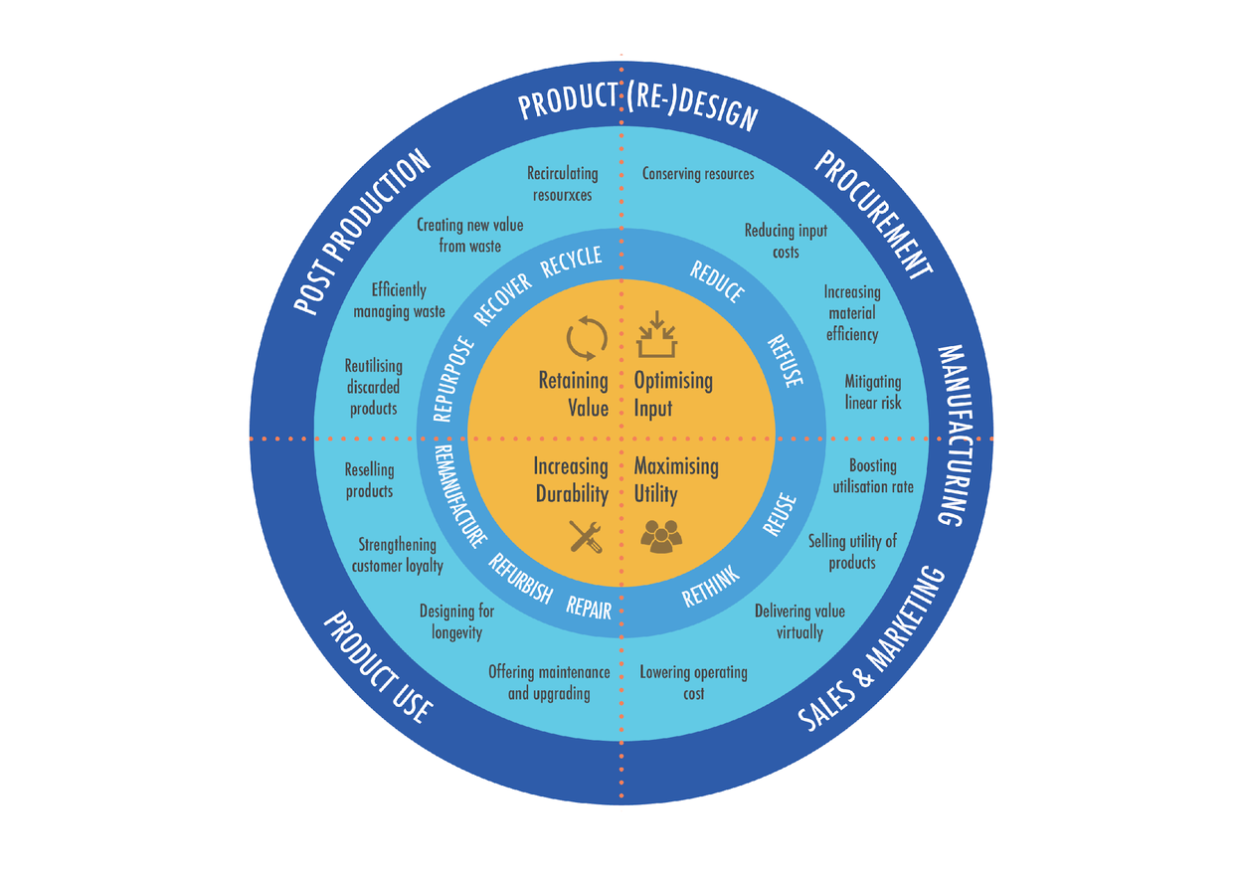
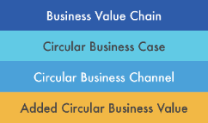
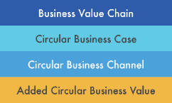
What are Circular Economy-related Business Opportunities?
Circular Economy Business Opportunities – Circular Economy Taxonomy
What are circular business opportunities?
There are a myriad of ways in which a business can create positive economic benefits by going circular. Take a look at the Circular Economy Taxonomy on the left: what you see is a collection of pathways that enterprises can take to achieve their goal of circularity.
  Starting from the inside, the four orange quarters represent the circular business values that are inherent in each circular measure you may take. If you, for example, decide to open a used smartphone shop, you effectively increase the durability of the phones by refurbishing broken ones that would otherwise have reached the end of their product life.
  One step outward, the taxonomy shows you which channels you may take to turn a circular business value into action. In the phone shop example, you would repair or refurbish old smartphones.
  One step further outward you find the circular business cases. These represent the actual revenue-generating activities you engage in with the channels you chose. Your smartphone shop would only generate income by reselling their refurbished products.
  The outermost layer of the taxonomy regards the business value chain in which your circularity activity most likely takes place. The used phone shop does not increase the circularity of a marketing process, but rather affects how (long) a product is used.
  The Circular Economy Taxonomy is a core concept of this toolkit and referenced multiple times in the tools ahead.
This CE business opportunity graphic and content is developed under Circular Economy Catalyst project funded by IKEA Foundation and implemented by adelphi. https://www.thecircularcatalyst.com/
11

Slide 13

What are Circular Economy-related Business Opportunities?
What are circular business opportunities?
A combined adoption of eco-innovation and life-cycle thinking is needed for the formulation of circular economy strategies. These strategies can be grouped into six main areas of opportunities. Take a look at the Circular Economy Framework on the left: what you see is a collection of circular economy opportunities that enterprises can create value in the circular economy. The strategies and opportunity groups are linked with different lifecycle stages of a product.
From the producers’ perspective, the value of finished, marketed and sold products can be retained as long as their functionality is maintained and they can be reused and given successional lives. Keeping a product’s value high over a long period of time requires a shift at the managerial, organisational, mindset, and even political, levels as well as high-level coordination within product value chains.
From the consumers’ perspective, the business strategies would provide a different customer experience compared to the traditional product purchase, with an emphasis on the functionality and the intangible value behind the product.
The inner circle of the Framework highlights different business channels. Depending on the local context and your conditions, you may take them to turn a circular business value into action.
The Circular Economy Framework is a core concept of this toolkit and referenced multiple times in the TOOLs ahead.
Procurement
Manufacturing
Shift to circular supplies
Increase resource efficiency
RETHINK REDESIGN REDUCE REUSE REPAIR RESTORATION RESELL RECYCLING RECOVERY REPURPOSE
Product
(re)design
Shift to service-based models
Recover after disposal
Sales and
marketing
Extend the life-time of products
Facilitate demand for circular products & services
Post
consumption
Use
Lifecycle stages
CE strategies & opportunities
Business channels
This CE business opportunity graphic and content is developed under Circular Economy Catalyst project funded by IKEA Foundation and implemented by adelphi. https://www.thecircularcatalyst.com/
12

Slide 14




What are Circular Economy-related Business Opportunities?
The Circular Economy Dimensions
To make a product, resources are used and their flows move in a production process. In the circular economy, the flow of resources is considered as a circle, the so-called “loop”. Circular business models can alter the flow of resources within a production loop to minimize the resources entering the loop or keep the resources within the loop for as long as possible. Thus, circular economy brings added-value to businesses through narrowing, intensifying, slowing or closing the loop of resources (Weetman 2020).
  Optimising input – “narrowing the loop”: less resources are used to make a product or service, hence less resources enter the loop, and the narrower the loop is.
  Maximising utility – “intensifying the loop”: the more users a product/service reaches, the more use is made of the resources that went into making the product/service, thereby intensifying the reach of the loop.
  Increasing durability – “slowing the loop”: by keeping resources in the loop for as long as possible by repairing products or designing them to last for a longer period time, the flow of resources through the loop is slowed down.
  Retaining value – “closing the loop”: By recycling or recovering resources that have reached the end of their product life, the value of the resources is retained by redirecting them into a new loop and thereby closing the previous loop.
Added Circular Business Value
Optimising input
“narrowing the loop”
Maximising utility
“intensifying the loop”
Increasing durability
“slowing the loop”
Retaining Value
“closing the loop”
13

Slide 15


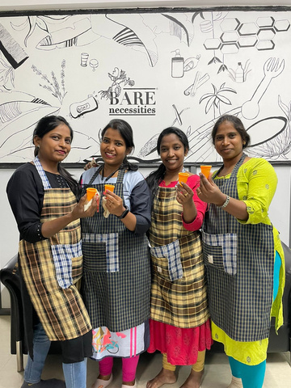
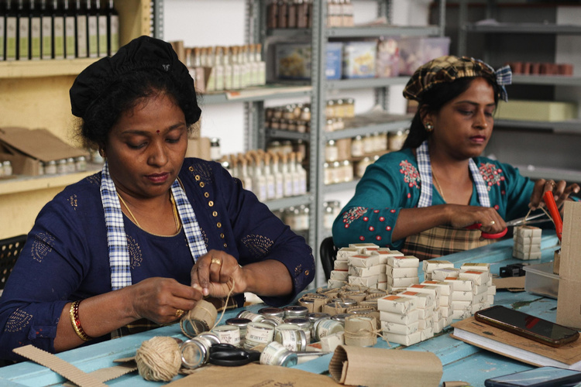

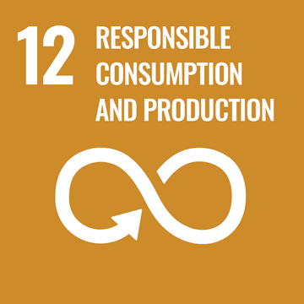
Case Study - Bare Necessities Zero Waste Solutions Pvt. Ltd
About the Enterprise:
Bare Necessities is a women-founded, women-led beauty and home care brand that operates on zero-waste principles to create alternatives to products conventionally packaged in plastic and formulated with toxins, thereby addressing the global challenges on plastic waste and human health of our lifetime.
Products & Services:
The Bare Necessities innovative, waterless and plastic packaging-free monthly dishwash, hand wash and multi surface cleaner soaps sold in a seamless
subscription system; a celebration of circular economy in action rather than the traditional (use and throw) linear approach.
Triple Bottomline Impact:
The company aligns its work with UN SDGs and keeps the triple bottom line in mind while measuring impact - people, planet, and profit. As of 2023, Bare Necessities has sold 179,547 products, which has saved 103,096,156 plastic units from either going into a landfill or the environment (published in the annual impact report). They have had a direct impact on 372,577 people and indirect involvement with 1,73,449 through markets, talks, and workshops.
Contributing to SDGs:

Slide 16

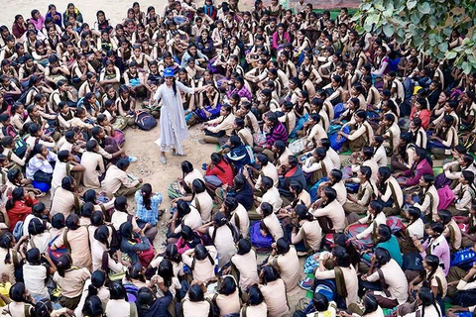
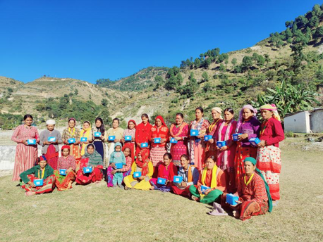

Case Study - Project Baala
About the Enterprise:
At the confluence of gender, culture, and health, the pressing challenges of menstrual awareness and hygiene in India come to the forefront. With a staggering 71% of adolescent girls initially uninformed about menstruation and significant consequences like school dropouts and lost productivity, it's evident that merely providing disposable sanitary napkins is not a sustainable solution. To tackle this, Project Baala, has crafted a distinctive model that not only addresses menstrual education and product access but also generates long-term employment, striving to create a period-positive society where all individuals can navigate this natural biological process with dignity and equity.
Products & Services:
Project Baala is a socially impactful enterprise in India, tackling menstrual health challenges with a comprehensive three-pronged approach. They provide innovative reusable sanitary napkins, offer awareness modules to break taboos, and create livelihood opportunities for women. Project Baala's circular economy focus extends to minimizing waste while fostering awareness and financial independence.
Triple Bottomline Impact:
Project Baala excels in the triple bottom line by delivering social, environmental, and economic benefits. They empower marginalized women with sustainable menstrual solutions, reducing waste. This leads to improved health, increased income, and a cleaner environment, with a social return on investment of $10.43 for every $1 invested, and a focus on promoting gender equity and inclusivity.
Contributing to SDGs:

Slide 17

Case Study - Aakar Innovations
About the Enterprise:
Aakar is a hybrid social enterprise that consists of Aakar Innovations and Aakar Social Ventures which focuses on sustainable period care. Aakar Innovations specializes in the production of sustainable sanitary napkins. Meanwhile, Aakar Social Ventures engages in the broader social impact of menstrual health, including awareness and sensitization across underserved communities.
Products & Services:
Aakar shows their commitment to sustainability throughout the entire process, from sourcing raw materials to production and disposal in developing their Anandi Pads. They use biobased materials that are free from plastic and harmful chemicals. Their materials are locally sourced and come from indigenous waste such as jute, bagasse, and other fibers. This approach allows them to expand the lifecycle of waste. Unlike other feminine hygiene products that take years to degrade, Anandi Pads decompose and turn into manure within 90-180 days.
Triple Bottomline Impact:
Aakar Innovations assesses the effectiveness of its circular initiatives through a comprehensive set of key metrics that reflect their impact on both women's well-being and environmental sustainability. These metrics include measuring the total number of customers reached to gauge outreach, employment opportunities generated, the quantity of eco-friendly menstrual hygiene products sold and distributed, compost generated, plastic waste reduced, and carbon emissions reduced.
Contributing to SDGs:

Slide 18

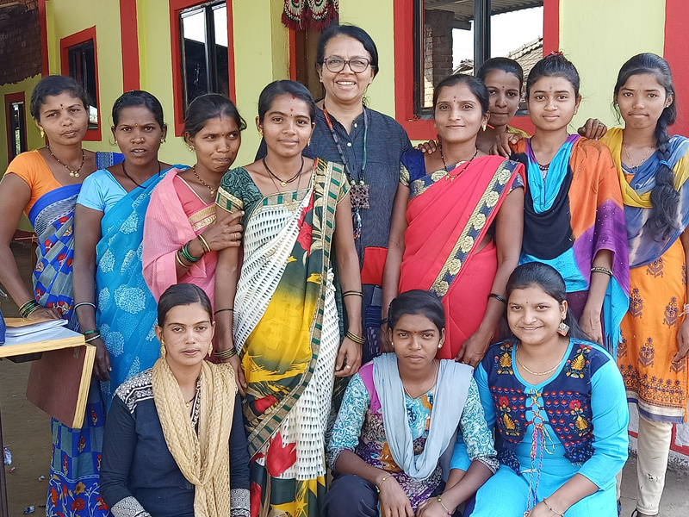
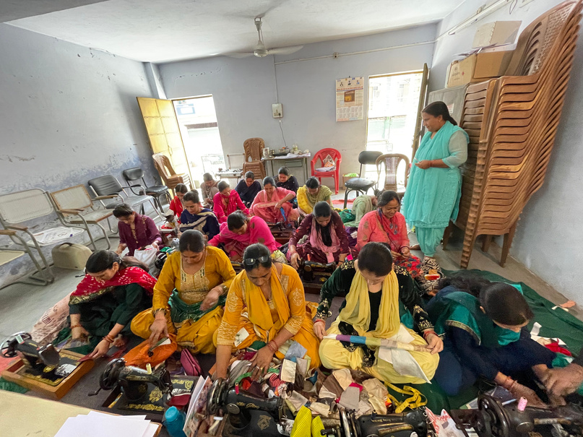
Case Study - Bunko Junko
About the Enterprise:
Bunko Junko is a sustainable fashion brand that works on pre-consumed textile waste and recreates fashion products out of it. The company is deeply committed to empowering rural women through basic skill development such as stitching and tailoring ensuring that they can access meaningful employment.
Products & Services:
Bunko Junko operates with a distinctive business model centered around upcycling textile waste into high-quality products. Their target audience comprises environmentally conscious individuals and businesses appreciative of sustainable fashion, home furnishings, and gifting products. The main revenue streams include the sale of upcycled products, collaborations, and social welfare initiatives.
Triple Bottomline Impact:
Bunko Junko measures the success of their circular initiatives through metrics such as the volume of textile waste diverted, the number of women employed and trained, and the reduction in our carbon footprint. These indicators reflect our commitment to sustainability and women's empowerment.
Contributing to SDGs:

Slide 19


Tool:
Value Proposition Building

Slide 20
Value Proposition Building
When?
Steps
The tool should be used by the enterprise as a starting point for developing a shared, deeper understanding of its purpose and the value it creates for its customers and all its stakeholders. Ideally, the value proposition should be developed in the enterprise’s initial planning phase. However, it is always useful to clarify and update your Value Proposition, especially when you are preparing to grow a next step and are looking for partners to support this growth.
1
  Identify values created and received
2
  Define your Value Proposition
Key outcomes
What?
The Tool offers a structured approach for refining or building a company’s value proposition not only towards its customers, but towards all its key stakeholders. In two steps, it provides an analytical frame to identify values created and received between a company and its customers, partners, community and institutions in its business environment.
  Understand that building or redefining an enterprise’s value proposition has implications for the overall design of the business model
  Identify the different types of values that the enterprise creates and exchanges with other actors
  Build strong and compelling arguments for all stakeholders on the value of your enterprise for them
How?
As the Tool builds on creative and interactive brainstorming-sessions, it is best done with a group of team members and possibly also partners from different backgrounds.
17

Slide 21















Value Proposition Building
Step 1
Identify values created and received
The first step is to identify the values created for, and received in return by each actor group. The four actor groups are:
  Step 1 & 2 are done for each actor group separately, starting with one actor group.
  To identify the values created think about the benefits your enterprise in generating for each of the four actor groups:
  Is your product or service solving a problem?
  How does the solution (the product/service that you are offering) overcome the problems it aims to solve?
  Does the solution bring an innovative approach into existing processes?
  Is your product or service helping costumers or the community become more climate resilient?
  Values received mean the benefits your enterprise receives in return for its products or services from each of the four actor groups:
  What do the actors offer your enterprise in return for your products or services?
  How do the actors contribute to your enterprise independent of the products or services you offer?
  The mutual value generation can take different forms; here are some examples of values created and received:
  Discuss the values your enterprise is creating for the actor group “customer” and receiving in return from them. Add your results to the worksheet on the next page, using symbols to indicate the values created and received.
  Different types of values created identified
  Expectations from different actor groups identified
 | Individuals and entities buying your product or services
Customer
 | Suppliers, distributors, competitors…
Partner
 | Technology
 | Money/ Revenue
 | Neighbours, employees, community leaders, CBOs…
Community
 | Energy
 | Health
 | Local, national government, government agencies…
 | Employment
 | Research
Institutions
 | Education
 | Goodwill/ Loyalty
 | Networks
 | Environmental Conservation
18

Slide 22
Step 2
Define your Value Proposition
Value Proposition Building
Visualising the values created and received will help you identify the key advantages and benefits your enterprise delivers, i.e. define the unique value proposition of your enterprise. One of the key purposes of the value proposition is to set you apart from your competitors. It should communicate clearly to the four actor groups how they benefit from contributing to your enterprise.
  After you have developed a first draft of putting your value proposition into just one sentence, it is useful to assess it with the “4C” approach, by asking yourself how crucial, compelling, concrete and credible it is:
  Crucial: Is the value proposition vitally important for customers?
  Compelling: Is it emotionally engaging or motivating?
  Concrete: Is it tangible and practical?
  Credible: Is it credible, realistic and based on what you can actually deliver?
  Use the box in the middle of the worksheet to write down your Value Proposition
  You can create slightly different versions for each stakeholder group, but one combined sentence should also be developed that best characterises your enterprise’s value proposition as a whole.
  Key benefits and advantages of your enterprise summarized in one slogan
19

Slide 23






Value Proposition Building
Value Proposition Building – Example: Rain-fed vegetable farming using drought resilient crops
Customer
  Pay for products & generate revenues for business
  Stay loyal to your product & ideally recommend product
  Provide employment
  Provide training
  Community development through joint projects
  Increase food security
Community
Step 1
Step 2
e.g. employees, community
  Affordable and reliable vegetable supply
Your Value Proposition:
Provide an affordable range of vegetables for the community and advancing climate change adaptation solutions and knowledge
  Provide necessary human resources
  Take part in business improvement processes
  Provide important market & customer information
  Provide information on improved crop cultivation management
  Have a loyal, trustworthy partner to do business with
  Good quality service
  Expanding regional networks
  Have a loyal, trustworthy partner to do business with
  Good quality service
  Knowledge about drought-resilient varieties
  Provide advice and technology in climate change adaptation & governmental support
e.g. Department
of Agriculture,
Farmers Association
e.g. Supplier in neighbouring country
20
Partner
Institutions

Slide 24

Value Proposition Building
Customer
Community
Step 1
Step 2
Your Value Proposition:
Partner
Institutions

Slide 25
Tool:
Circular Economy Compass

Slide 26

Circular Economy Compass
When?
Steps
An essential first step in your circular economy enterprise journey is to understand where you want to locate your business in the circular economy universe. You can revisit and reread this tool whenever you feel the need of bringing your business ideas back in line with your circular economy compass.
1
  Identify your interest in the circular economy
2
  Brainstorm circular business models
What?
You have noticed during the introduction to the concept of the circular economy, that there are numerous possibilities for businesses that want to adopt circular practices. To gain insights into the methods and locations for creating a circular business, use this tool as a means to explore and generate ideas: which aspects of the circular economy do you want to explore? Can you think of business scenarios that interconnect these aspects with different sectors?
Key outcomes
  Determine your team member interests in circular economy dimensions and sectors
  Compile a list of potential business models that combine your collective insights
How?
Creating a compass for the circular economy involves a combination of personal reflection and team brainstorming. To commence the process, find time for yourself, and a conducive environment. Revisit the Circular Economy Taxonomy provided in the toolkit's introduction. Subsequently, gather your team and explain your specific interests in the various dimensions and sectors of the circular economy. Start brainstorming sessions to explore potential business models aligned with the principles of the circular economy.
23

Slide 27

Step 2
Identify your interest in the circular economy
Step 2
Brainstorm circular business models
Firstly, revisit the four added values of the Circular Economy Taxonomy and consider the guiding questions listed below. Do you see opportunities to provide these added circular economy values in your sector? Prioritize the added values from most to least interesting. Take your first and second highest ranked added values and add them to the WORKSHEET Circular Economy Compass.
Within your group, engage in a discussion to explore the reasons behind your team members’ interest with specific added values within your chosen sector. Now, let's unleash your creativity! Brainstorm potential business models that integrate your sector with the two selected added values of the circular economy. Use bullet points to outline at least two business models per added value. Concluding, consider the possibility of connecting these business ideas and highlighting them using a one color.
CE Added values | Explanation | Questions
Optimising input | use regenerative resources and inputs, produce resource-efficiently | Do you want to use waste/recovered byproducts to make your product / service? Do you want to make a product / service using local or regenerable materials / resources?
Increasing durability | extend product life | Do you want to extend the life span of a product / service? Do you want to repair existing products?
Maximising utility | provide user-oriented services to maximise product utility | Do you want to offer a product / service which can be shared by multiple users/communities? Do you want to offer a product / service digitally?
Retaining value | use waste as a valuable resource | Do you want to create new products from waste? Do you want to collect and/or sell waste?
Enterprises often provide multiple values and can connect across sectors, circular economy added values, and activities. Think about which of your ideas could connect!
24

Slide 28
Example: Retaining value and maximising utility in the interior design sector
Step 2
Business Models
Added circular business values
Business Models
Step 1
  Creating an online platform or app where ceramic manufacturers, designers, and artists can trade surplus ceramic materials, reducing waste, redesign or new design of products, and promoting resource efficiency.
  New ideas of using environmentally-friendly packaging materials for your products?
  Collect discarded or broken ceramic products, recycle them into raw materials and create new ceramic products for home decor, like vases, bowls and similar items.
  New ideas on how to use new materials from other wastes for ceramic products?
Focus Sector
Ranked 1:
_____________
Ranked 2:
_____________
Retain value
Maximise utility
Your chosen sector:
Ceramics & Interior Design
25

Slide 29
Example: Retaining value and maximising utility in the interior design sector
Step 2
Business Models
Added circular business values
Business Models
Step 1
Focus Sector
Ranked 1:
_____________
Ranked 2:
_____________
Your chosen sector:
26

Slide 30
Tool:
Circularity Intensifier

Slide 31
Circularity Intensifier
When?
Steps
The tool is best applied when new businesses want to integrate further circularity elements into their operations. This includes looking at how circularity can be targeted in each step of a value chain, and critically reflecting on activities to increase process circularity by improving the management of value chain inputs and outputs.
1
  Map your value chain
2
  Highlight process circularity opportunities
3
What?
  Boost your circularity
This tool offers a structured approach to identifying aspects in your value chain that contain circularity opportunities, including in product design, procurement, manufacturing, sales and marketing, product use and post-production.
Key outcomes
How?
  Map the key steps of your value chain
  Highlight elements within your value chain that have high circularity potential
  Integrate circularity elements into your value chain to profit from its economic and environmental benefits.
This tool works best when you implement it with team members of each critical value chain step. This would include those involved with product/service design, procurement, manufacturing, sales and marketing, product use and post-production.
28

Slide 32
Steps – Circularity Intensifier
Step 1
Map your value chain
As a first step, map your enterprise activities, including every input and output – from product/service design to post production/service. Each aspect of operations may hold potential to add circular value to your business model. The basic steps of a value chain are:
Keep in mind to adapt the structure if needed for your business model, e.g. Research & Development might be an important step for some, whereas others may focus more on post-production repair and maintenance activities. Adapt the wording of the value chain to also reflect your core activities: agro-processing enterprises would rather refer to “Cultivation/Processing” instead of “Manufacturing”, for example.
Inputs and outputs can be elements as diverse as packaging material, energy costs for cooling, fuel for transportation or high-speed internet on the input side, and waste water, rice husks or methane gas on the output side.
The following questions may help to identify relevant activities:
  Which raw materials or components need to be procured?
  What (by)products are produced in each step?
  Which steps are involved in assembly and production, or delivery of a service?
  How do you distribute your products or services?
  Through which channels do you reach your customers?
  How can the product be repaired, refurbished or remanufactured during its product life? What services are related to this?
  What happens with the product at the end of its product life?
  Use the Circularity Intensifier WORKSHEET to identify the key steps of your value chain and which activities you perform under each step. Activities can be as diverse as the supply of raw materials, different production steps, transport, storage, trainings etc.
Product/ Service Design
Pro-curement
Manu-facturing
Sales & Marketing
Product/ Service Use
Post Pro-duction/ Service
29

Slide 33
Steps – Circularity Intensifier
Step 2
Highlight process circularity opportunities
Now, highlight elements of your value chain that offer opportunities for you to increase your process circularity. In Step 2 of the Visual Prototyping TOOL, we first introduced the two forms of circularity in businesses: product circularity and process circularity. Product circularity involves designing a product that is conducive to resource-saving, and –generating as well as to maximising product life and utility. Process circularity looks at what steps of your value chain are composed in a regenerative and resource-saving way. To improve process circularity you can ask yourself: what can I do at each step of my value chain to get the most utility and value of all inputs used and outputs created?
To find process circularity opportunities, revisit the key steps and activities in your value chain identified in Step 1. Ask yourself the following questions:
  Can the input(s) of this activity can be replaced with something less environmentally damaging/renewable?
  Can the output(s) of this activity be used (either by my enterprise or by others)?
  Could other actors come in to take care of activities more resource-efficiently or do they have knowledge that you could access?
  If your answer is “yes” to any of the questions when thinking about the inputs/outputs of your value chain activities, highlight them in the following WORKSHEET.
30

Slide 34


Circularity Intensifier
Example: Ethanol gel production from sugar cane
Step 1
 | Key steps of your value chain | Key steps of your value chain | Key steps of your value chain | Key steps of your value chain | Key steps of your value chain | Key steps of your value chain | Key steps of your value chain
 | Product Design | Procurement | Manufacturing | Sales | Marketing | Product Use | Post Production
Prototype development
Raw material sourcing (molasses from sugar cane, water)
fermentation
B2B sale
Website
Empty can collection
In: different org.
waste, water, heat,
fermentation and
distillation equipment
Out: various prototypes
with varying purification
degrees, waste water,
methane
In: sugar cane, water,
money, labour (workers),
pick-up truck, fuel
Out: emissions
In: Sugar cane molasses,
water, yeast
Out: 8% alcohol con-
centrate, organic waste
In: virtual shop, IT service,
customer service, fuel,
transport truck
Out: emissions, electricity
In: IT service
In: labour, pick-up truck, fuel
Out: emissions,
metal waste
SEO (Search Engine Optimisation)
Procurement of machinery to process
distillation
In: money
Buyer relations
In: alcohol concentrate,
energy
Out: 96% ethanol,
distilled water
sale to wholesalers
B2B exhibitions
In: money
In: customer service
Storage of inputs
In: fuel, transport truck
Out: emissions
In: print material (banners, flyers), money
Activities, Inputs and Outputs
Storage of ethanol
In: energy (cooling)
In: ethanol tanks, ethanol, storage facility
Storage of main product
Mixing unit
In: storage space, security
In: ethanol, gel
Out: main product
Canning
In: ethanol, gel, cans
Out: main product
Step 2
Highlight process circularity opportunities in your value chain
31

Slide 35
Circularity Intensifier
Example:
Step 1
 | Key steps of your value chain | Key steps of your value chain | Key steps of your value chain | Key steps of your value chain | Key steps of your value chain | Key steps of your value chain | Key steps of your value chain
 | Product Design | Procurement | Manufacturing | Sales | Marketing | Product Use | Post Production
Activities, Inputs and Outputs
Step 2
Highlight process circularity opportunities in your value chain
32

Slide 36
Steps – Circularity Intensifier
Step 3
Boost your circularity
Now, look at integrating circularity aspects into your value chain to add circular value that benefits both your business (lower costs, reputation) and the environment.
Start by considering concrete activities and measures that could address the highlighted aspects in Step 2, and contribute to integrating circularity into your value chain:
  Which specific activities and measures can be implemented to reduce the dependency on non-renewable inputs used in your value chain?
  Which activities can make use of non-utilised outputs or byproducts generated in your value chain?
  Can the circularity activity be implemented without requiring additional resources and incurring additional costs?
  Which outputs could be used productively by potential partners?
  For which step of the value chain is circularity particularly relevant?
  What is the timeframe for implementation of the resilience activity? Is it already ongoing, upcoming or planned in the future?
  Use the WORKSHEET Boost Your Circularity to note down your ideas. Below you can find an example as guidance.
Circularity activity | Relevant value chain step | Timeframe (ongoing, upcoming, planned) | Can the activity be integrated/leveraged? If yes, how?
Source organically produced sugar cane | Procurement | Already going on | Yes. Organic sugar cane producers are in talks, first quality tests scheduled in a month
Turn fermentation biogases into energy source for distillation | Manufacturing | Planned in the next year | Yes. Contracted energy consultant for first quotation on installing biogas system
Re-design cans to be reusable | Product Design | Planned in the next 2 years | Yes. Need to contract packaging designer
Send organic waste to briquette producers | Manufacturing | Planned in the next six months | Yes. Initial market research on suitable candidates. Testing calorific value of sugar cane residue
33

Slide 37
Steps – Circularity Intensifier
Step 3
Example:
Circularity activity | Relevant value chain step | Timeframe (ongoing, upcoming, planned) | Can the activity be integrated/leveraged? If yes, how?
34

Slide 38
Tool:
Understanding Impact

Slide 39
Understanding Impact
When?
Steps
Impact lies at the essence of any circular enterprise, and it is important for every enterprise to reflect on the different types of impact of its activities. This tool is useful for enterprises in early stages and whenever preparing team members to rethink and analyse the enterprise impact.
1
  Analyse the impact value chain
2
  Collect & prioritise impact areas
3
What?
  Clarify impact monitoring goals
This tool supports impact analysis and monitoring. It enables the team to identify key concepts and frameworks such as the triple bottom line approach and the impact value chain and to apply them in a simple and effective way to support the individual needs of the enterprise.
Key outcomes
How?
  Gain clarity about your impact monitoring and management approach
  Define what you want to achieve in terms of economic, environmental and social impacts
  Analyse how this can be measured and presented
This tool is best applied in a workshop setting with the whole team to ensure a shared sense of relevance of impact measurement and reporting. It should always be revisited before working on impact measurement and can also be used as a knowledge resource.
36

Slide 40
Steps – Understanding Impact
Step 1
Analysing the impact value chain
INPUT
OUTPUT
OUTCOME
IMPACT
  Organic household waste
  Black soldier fly larvae
  Composting practices and equipment (e.g. hydraulic compost turner, granulator, rotary drum cooler)
  Labour, Money, Time
  Energy for drying process
  Pick-up trucks, fuel, plastic packaging
Even if the enterprise is small, you can contribute to solving global challenges. To present how your enterprise achieves its impact goals and how they are linked to larger development efforts and strategies, go through the Impact Value Chain for each key Impact Area and complete the worksheet. Be sure to include circularity impacts as well.
INPUT includes everything you invest at all value chain steps – e.g. money, time, resources, product inputs, but also packaging, electricity, fuel, promotional material, etc. As inputs usually incur billable costs, this is often well-documented.
OUTPUT refers to all direct results of your enterprise activities at all value chain steps. Apart from the obvious product/service delivered, your enterprises produces lots of other things: production residuals, waste oil, wastewater, empty printing cartridge, etc. While the directly sold products/services are usually well-documented in your records, those that are not (yet) used productively are often not.
OUTCOME refers to the positive effects of your output – by selling clean cook stoves, for example, ask yourself how many traditional stoves have been replaced, how much charcoal substituted and how many trees could be saved? This needs to be precisely calculated using credible formulas, based on proof through scientific data or well-regarded institutions. Investing time to research the right sources really does pay off.
IMPACT refers to the wider context. What are the local and global challenges that your outcomes are tackling? Typically, you will not be able to calculate how much your enterprise is reducing climate change effects in your region – but you should be able to find and cite a credible study linking your activities to a clear contribution to a positive change.
count it
  # kg of org. fertiliser produced
  # kg of dried black soldier
  fly chicken feed
  Filtered residues
  Ashes
prove it
  Improved soil nutrient status
  Increased yields during dry season
  Improved chicken health
link it
Contributing to:
Reduced soil degradation and increased local community wellbeing (increase of local incomes, food security)
37

Slide 41
Steps – Understanding Impact
Social Impact | Environmental Impact | Economic Impact
Job creation Skills training Community strengthening Women empowerment Increased mobility Increased access to education, health services, infrastructure | Provision of environmental awareness, training and education Changes in community choices and actions Increased product lifecycles Reduced pollution and waste Use of regenerable resources Protection of local biodiversity | Strengthened local economy and value chains Increased the income of vulnerable groups Higher producer price premiums or prices for smallholder farmers Reduced input costs for other businesses
Step 1
Analysing the impact value chain
Business results are typically measured in financial and economic terms, and strategic goals set in categories such as sales or market coverage. To account for the complexity of the context of doing business, many enterprises have expanded the purpose and goals of their business activities to include their social and environmental responsibility and effects.
“Sustainable business” is therefore the managerial paradigm based on the three pillars, “people, planet and profit”, which are reflected in the so-called triple bottom line, which includes the social, environmental and economic results of the business.
Dimensions of the Triple Bottom Line:
First, compile an overview of all areas of your enterprise impacts across the Triple Bottom Line. What is the purpose of your enterprise, why are you doing what you are doing and what specific impact on the community are you trying to achieve?
Collect all of these goals and structure them along the categories of the triple bottom line as listed in the table above. Then, take a look and identify additional impact areas that your team did not think about immediately: where else are you creating impact already? Where else could you create impact by making some additional effort?
Complete your list and then rank the impact areas according to priority. If you could not achieve all of these impact goals, which one(s) would you drop first?
Environmental
Social
Economic
38

Slide 42
Steps – Understanding Impact
Circularity along the impact value chain
Here it is important that you also consider as well how your enterprise contributes to a shift in the economy.
Consider the benefits of circularity that your enterprise offers. Think about the wider positive impact that these benefits may bring to the ecosystem and/or stakeholders.
  You find a few exemplary circular impact advantages below:
  Once you have ranked your impact areas according to priorities, add a circularity icon to each area that is a circular advantage.
Step 3
Clarify impact monitoring goals
  Monitoring the quantitative and qualitative impact of any business activity is a science of its own and can seem like a daunting task for a small enterprise. It is therefore essential to use a simple system and define a tailored approach. Similar to preparing a pitch presentation, as a first step, define the core goals and relevant target audiences of your impact monitoring efforts.
  What information do you need to collect to see whether you are on the right track with your enterprise activities?
  Who is already interested in your performance and impact and which additional stakeholders or partners do you want to convince?
  What are your partners’ key priorities and what kind of data and information will they appreciate most?
Social Advantages | Environmental Advantages
Reduced vulnerability of communities otherwise affected by negative effects of primary resource extraction Shift away from extractive methods that are often unsafe and lead to health issues among employees Preserve local ecosystems and sources of key resources such as water | Decreased energy and water consumption, emissions of toxic substances and depletion of natural ecosystems Minimised unprocessed and unseparated waste Reduce pollution and waste, thereby reducing contamination of water sources and soil
Economic Advantages | Economic Advantages
Independence from highly fluctuating raw material prices Resilient supply chains (reduced vulnerability to supply chain shocks such as due to COVID-19) Reduced input prices and reduced dependence on critical minerals and metals Increased income for the industry by repurposing existing resources or upcycling | Independence from highly fluctuating raw material prices Resilient supply chains (reduced vulnerability to supply chain shocks such as due to COVID-19) Reduced input prices and reduced dependence on critical minerals and metals Increased income for the industry by repurposing existing resources or upcycling
39
Notes:
39

Slide 43
Steps – Understanding Impact
Example: rice residue packaging
Step 3
INPUT
OUTPUT
OUTCOME
IMPACT
Example (rice residue packaging):
- agricultural waste, binding agents, employee working hours, water, electricity
Example (rice residue packaging):
- number of rice residue packaging boxes @70% recycled material, waste water, heat
Example (rice residue packaging):
- reduced trees cut down for cardboard usage (2 trees per kg of boxes sold)
Example (rice residue packaging):
- reduced deforestation in region X, alternative jobs provided to women in the green economy, protection of biodiversity
40
Notes:
40

Slide 44
Steps – Understanding Impact
Step 3
INPUT
OUTPUT
OUTCOME
IMPACT
41
Notes:
41

Slide 45

Impact Areas
Step 2
Social Dimension | Rank | Environmental Dimension | Rank | Economic Dimension | Rank
42
Notes:
42

Slide 46

Impact Areas
What information do you need? | Which partners are/could be interested in your impacts? | What impact data will be most relevant for these partners?
Example: Purchasing data for all raw materials; Sales data for all rice boxes; Production and storage statistics; Employee statistics and salaries; Cost and revenue overview, profit data | Example: National Green SME Award scheme organizers; International Donors | Example: GHG emissions and trees saved, green jobs created; customer household health and social benefits etc.
Step 3
43
Notes:
43

Slide 47
Tool: Enterprise Pitching

Slide 48
Pitching
When?
Steps
You need a convincing business pitch as soon as you start to talk to potential investors, customers, partners, team members or employees. Update your pitch regularly as your business idea evolves and your target audience changes. Under the last phase DEMONSTRATE you will also find a TOOL for Advanced Pitching.
1
  Define your objective
2
  Develop your pitch
3
What?
  Make use of tips and tricks
This tool supports you in defining your objectives and developing a pitch based on these objectives. As great content does not necessarily make a great pitch, the tool also provides tips and tricks for presenting.
Key outcomes
How?
  Understand what matters when you develop and give a pitch
  Cater your pitch according to your business stage
  Explore how you can convince your audience with a strong pitch
In the end, only one or two people from your team will deliver the final pitch. However, everyone in your team should be ready to give a short pitch at any time. If you have your whole team on board while developing the pitch, you will come up with more ideas and can also give feedback to each other. Testing the pitch with your family and friends is also an important source of feedback and gives you confidence to present to others.
45

Slide 49
Steps – Pitching
Step 1
Analysing the impact value chain
Step 2
Develop your pitch
Start with the WHY. Designing a powerful pitch is all about reaching the hearts and minds of your audience. In order to achieve both, think of a balance.
The credibility of your business model should be balanced with the emotions you create by presenting your solution. In order to develop the perfect pitch, you and your team have to clarify the following questions upfront:
  What is your business development stage? When did you start the business idea and what have you achieved until now?
  Who are you presenting to and how much time do you have? Is it an investor, potential partner, your friends, a jury? Do you have 3, 5, 10 minutes or longer?
  What are you asking for? What do you want the audience to do after the pitch: speak to you, join your team, donate money, invest money, offer expert advice, etc.?
  Answer the questions in the WORKSHEET: Who is your target audience and what do you want from them? Before every new pitch, remember to go back to your key objectives, identify what is different this time and adjust the pitch accordingly.
Keeping in mind the context and audience, now it is time to develop your pitch. The AIDA Model gives you a structure for your pitch.
How can you best sell your idea? The AIDA Model:
A – Catch the Attention of your audience!
Comparisons, personal stories, bold statements, questions or visual descriptions of the problems you aim to tackle can help you catch the attention of your audience and make them curious to learn more!
I – Raise the Interest of your audience!
Connect to their context and emphasise advantages and benefits of your idea for the audience to which you’re speaking. Focus on how your solution is unique, and what you have already achieved.
D – Awaken the Desire of your audience to work with you!
Explain how you are meeting a need for them and demonstrate how they will gain from working with you or investing in you!
A – Call for Actions by your audience!
Invite the audience to learn more about you, support you, partner with you, purchase from you, or invest in you. Offer concrete possibilities and let them know how to get in contact with you!
46

Slide 50



47
Steps – Pitching
For content related to your particular pitch, go back to your WORKSHEET Problem-Solution Fit and Your Visual Prototype. The pitch summarises the key information you need to convey in the time you have available and is tailored to your specific audience. At this stage, you should focus on the following key aspects:
Key parts of the early stage pitch
  Problem
  What problem is out there? What are you solving for customers? What problems are you solving for other stakeholders? What positive environmental and social impacts are you having?
  Product / Solution
  In simple words, what does your product do for customers, other stakeholders, the environment? How does it work?
  Customer
  Who is your target customer? How have you tested or will you test it with customers?
  Use the WORKSHEET Your Pitch to develop your pitch. In your group, decide on the key content you want to cover, and what really makes you unique. Then, you can jointly work on the text for your pitch. Practice it in the group, and refine it.
Step 2
Make use of tips & tricks
A good pitch is not only about what you say, but also how you say it. Consider the following when it comes to the moment you have to pitch:
  Be able to summarise who you are creating value for and how
  Show emotions and heart – it is not only about numbers, but also about creating a brighter future
  Have your pitch ready at any time – chances come in the most unexpected moments
  Rehearse, rehearse and rehearse – practice at least 7 times before you walk on stage
  Feedback is the breakfast of champions – leave your ego at the door and focus on getting better every day
  Think about your grandmother – would she understand your ideas?
  Keep eye contact with your audience and make them feel important
  If you use PowerPoint or Keynote, have one page that summarises your idea perfectly and is easy to remember
  Know who you are pitching to, ask questions that stimulate the decision makers – keep eye contact with them
  There is no worksheet for this step, but make sure to read the Tips & Tricks and to take them into consideration.
  You will need to adapt your pitch to your business model. To do so and to prepare for any Question and Answer to your pitch, see the TOOL Advanced Pitching.
Keep the AIDA Model in mind and check what your pitch does to catch the Attention, raise the Interest, awaken the Desire and calls for Actions of your target audience!
You are not just setting up any kind of enterprise, but a circular economy enterprise. This is a unique selling point which you should stress!

Slide 51

Who is your target audience and what do you want from them?
What is your business development stage? | To whom are you presenting to and how much time do you have? | What are you asking for?
Having started just 3 months ago, we have proven (through interviews) that our problem exists and that our solution works. We are currently developing our minimum viable product… | We are presenting to the CEO of Foundation X and her management team. The appointment takes 30 minutes, so we decided to present to them what we have achieved in 5 minutes so as to leave enough time for their questions… | We are asking for a partnership with Foundation X in order to cooperate with the development of our minimum viable product both in terms of technical experience and finance…
Step 3
48
Notes:
48

Slide 52

Step 2
Your Pitch
  Attention?
  Interest?
  Desire?
  Action?
49

Slide 53
Leadership Modules

Slide 54
Imposter Syndrome
Leadership Module 1
51

Slide 55
What is imposter syndrome?
Imposter syndrome is a feeling of doubt and insecurity that where they believe they're not as competent or capable as others think they are, and they fear that they'll be exposed as a fraud or imposter, despite evidence of their skills and accomplishments. It's like feeling you don't deserve your success and that you're just pretending to be good at something when you're not.
A KPMG study finds 75% of female executives across industries have experienced imposter syndrome in their careers, which is a feeling of inadequacy and self-doubt that makes them continuously doubt if they are qualified enough for the job.
52

Slide 56
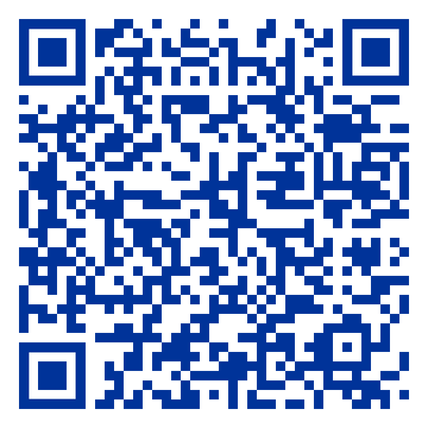
Imposter syndrome: Video module
Scan the QR code to watch the video module on Imposter Syndrome
<Insert video here>
53

Slide 57
Understanding Imposter Syndrome
  Identifying the type of Imposter Syndrome
  Reframing the rules to deal with it
  Applying strategies to tackle it
54

Slide 58
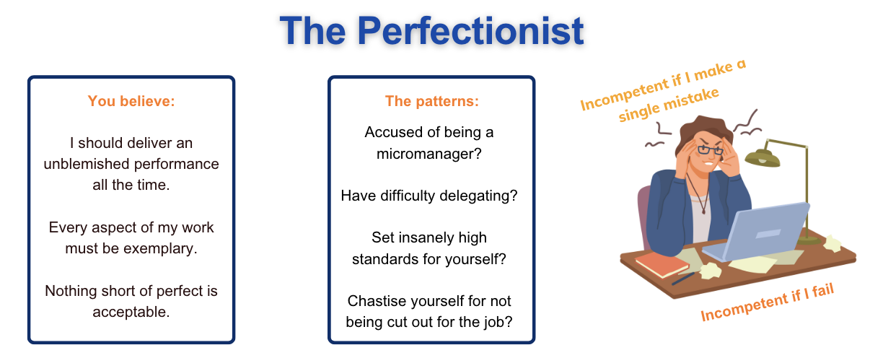
Type 1: The Perfectionist
55

Slide 59
Reframing rules for The Perfectionist
If you believe you are a perfectionist, tell yourself this:
  Perfectionism can actually hold me back
  Sometimes good is good enough’
  Not everything deserves 100%. Our perfectionism impacts others.
56

Slide 60
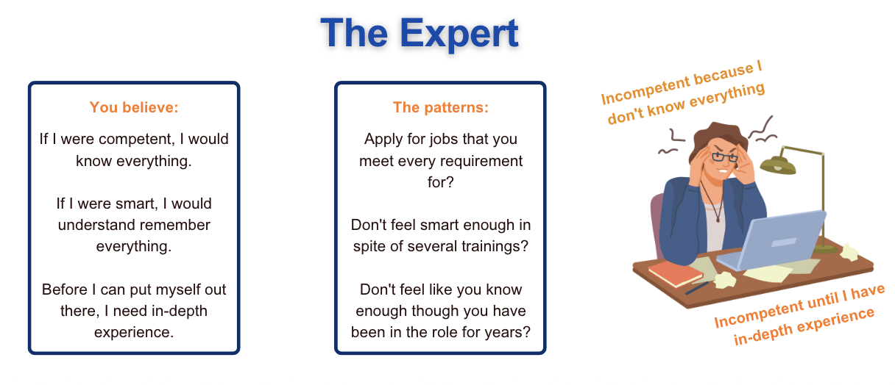
Type 2: The Expert
57

Slide 61
Reframing rules for The Expert
If you believe you are an expert, tell yourself this:
  There is no end to knowledge. Competency is a continuous process.
  Competence means acknowledging and respecting our limitations.
  We don't need to know everything. You just need to be smart enough to find someone who does.
58

Slide 62
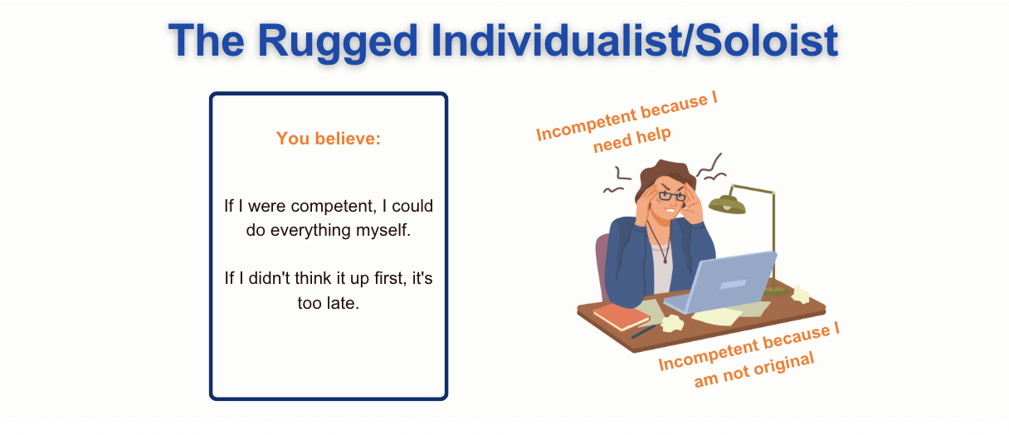
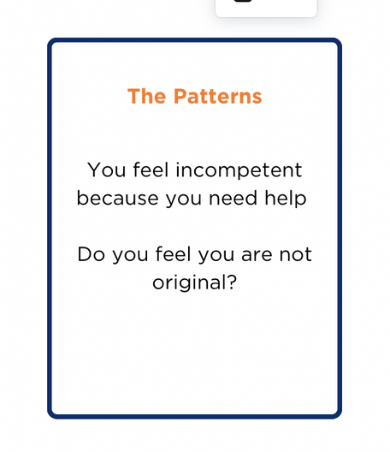
Type 3: The Soloist
59

Slide 63
Reframing rules for The Soloist
If you believe you are a soloist, tell yourself this:
  To get the job done, identify resources required. Competent people know how to ask for what they need.
  Your work does not have to be groundbreaking to be good. Competent people know it's okay to build on the work of other competent people.
60

Slide 64
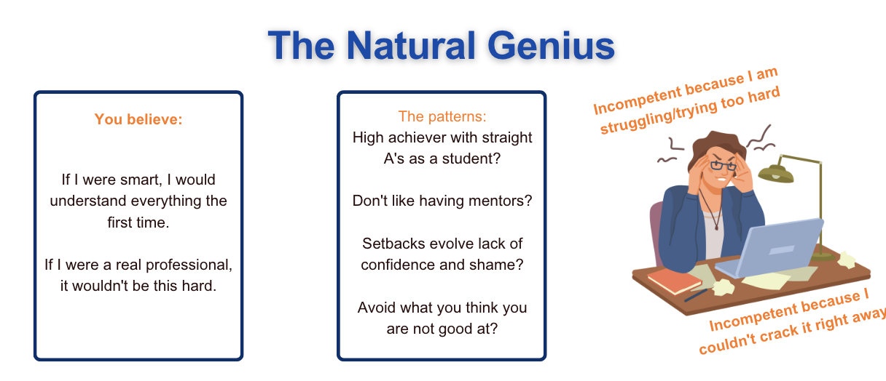
The Natural Genius
61

Slide 65
Reframing rules for The Natural Genius
If you believe you are a natural genius, tell yourself this:
  Effort trumps ability.
  Challenges are often opportunities in disguise. Real success always takes time.
62

Slide 66
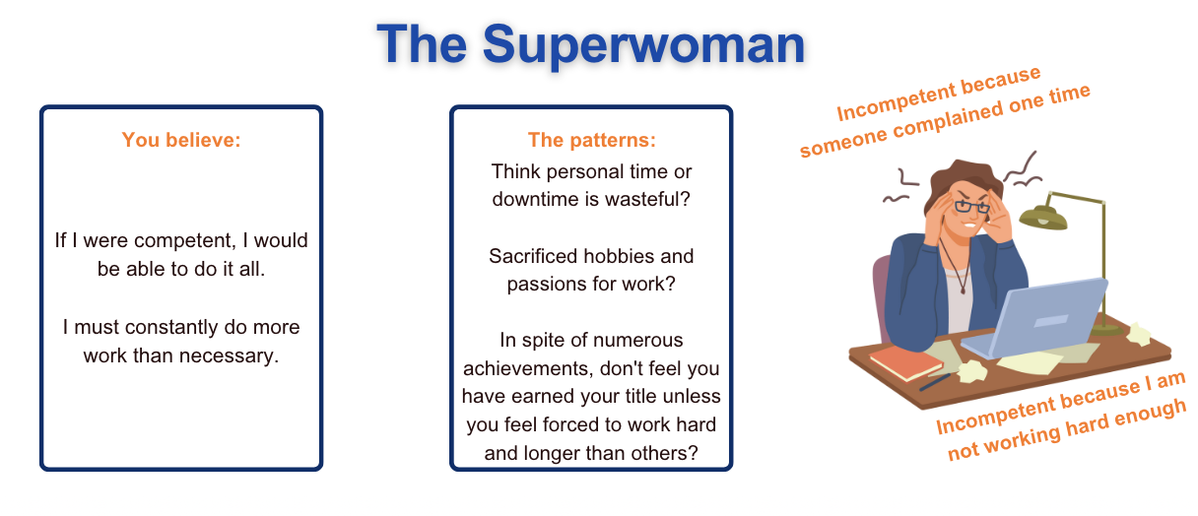
The Superwoman
63

Slide 67
Reframing rules for The Superwoman
If you believe you are a superwoman, tell yourself this:
  It's okay to say NO. Delegating frees you and enables others to participate and feel useful.
  When you slow down and cut out unnecessary tasks, you can focus on activities that really matter.
64

Slide 68
Tackling imposter syndrome: Live in your strengths
  Create a Journal. Fill it with your accomplishments, success, achievements, skill, positive feedback
  Identify your ‘support tribe’ - relatives, friends, colleagues, peer groups. These are people you can share your struggles with
  Use affirmations.
65

Slide 69
Tackling imposter syndrome: Address the root cause
  Address your history. Ask yourself: why this narrative? When did this first appear?
  Ask how it is helping you.
  Remind yourself that feeling like an impostor is a sign that you are progressing and challenging yourself in your field
  Unsubscribe from doubt.
  Fake it till you become it.
66

Slide 70
Reflection assignment
Read the following prompts and reflect on your own experience:
  Have you ever experienced imposter syndrome or felt like you lack confidence in the work that you do? Have you ever held back from doing something you wanted to do because you weren’t confident?
  What signs helped you recognize your imposter syndrome? How were you able to overcome your experience of imposter syndrome?
  How can you support someone with imposter syndrome? How can you make your organisation free of imposter syndrome?
67

Slide 71
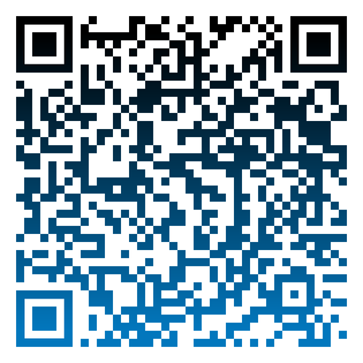
Reflection assignment
Scan the QR code to check out the reflections of the cohort:
68

Slide 72
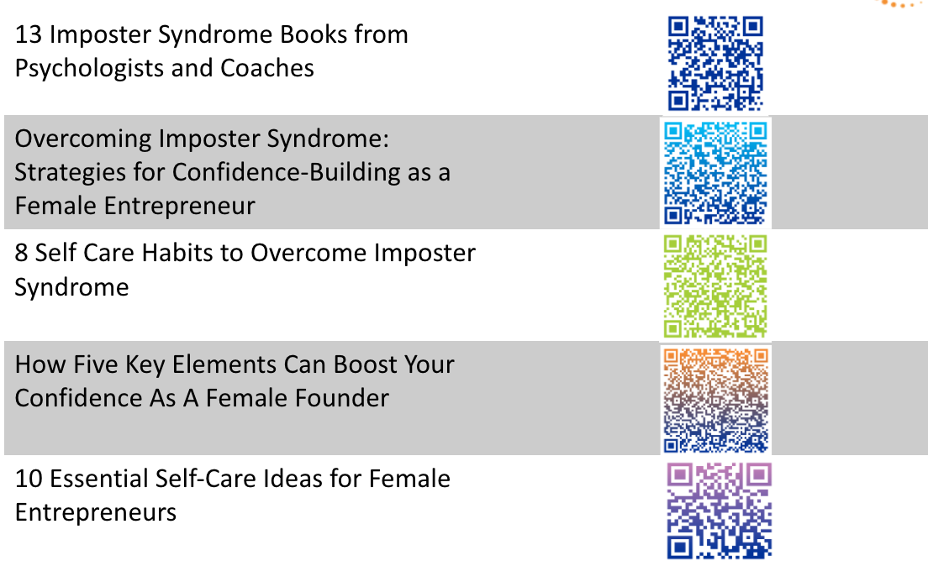
Additional Readings
69

Slide 73
Building a Strong Company Culture
Leadership Module 2
70

Slide 74
What is company culture?
  Company culture refers to the shared values, beliefs, behaviors, and norms that shape the work environment and interactions within an organisation. It encompasses the organisation's core principles, mission, and vision, as well as the way employees collaborate, make decisions, and conduct themselves on a day-to-day basis.
  A strong company culture defines the identity of the organisation, guides its employees, and plays a significant role in its overall success. It can be inclusive, innovative, customer-centric, or any combination of values and principles that the organisation prioritizes to create a unique and productive work environment.
71

Slide 75
Company culture and growth
  A positive company culture is integral to fueling growth by promoting employee retention, productivity, and innovation.
  Satisfied and engaged employees are more inclined to stay with the organisation, reducing turnover and associated costs
  This enthusiastic workforce is also more productive and innovative, contributing to the company's competitive advantage and overall expansion.
  A strong culture attracts top talent, enhances customer satisfaction, and strengthens the organisation's brand reputation - ultimately contributing to a more successful business.
72

Slide 76
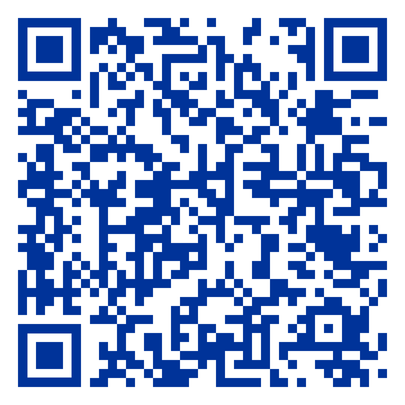
Building company culture: Video module
Scan the QR code to watch the video module on Building company culture
<Insert video here>
73

Slide 77
Essentials to build a company culture
  Be proud of the problem you are solving
  When your team takes pride in the purpose behind their work, it fuels motivation and a shared sense of purpose that's central to a positive culture.
  Create a long-term vision
  A compelling vision not only guides your organization but also inspires your employees, driving a collective commitment to future success.
  Identify your core values
  Articulating and consistently reinforcing your core values, especially when focused on customer needs and societal impact, can shape a culture that is meaningful and customer-centric.
  Inculcate diversity
  Cultivating a culture that values diversity and inclusion promotes innovation and broadens perspectives, creating a more dynamic and adaptable organization.
  Put a hiring plan in place
  A well-defined hiring plan ensures that new employees align with your cultural values and long-term vision, helping to maintain and strengthen your company culture.
74

Slide 78
Setting up for long-term success
  This is not a one-time exercise
  Recognise that culture is not a one-time exercise but a living, evolving foundation of your company that demands continuous attention and care.
  Consider Employees’ Social Needs
  Consider your employees' social needs and family requirements, acknowledging that humans are inherently social creatures with a work-life balance that matters to them.
  Show Empathy
  Show empathy as a core value because what will make people stay and thrive within your organization is the genuine understanding and care you demonstrate towards their well-being.
75

Slide 79
Reflection Assignment
Read the following prompts and reflect on your own experience:
  What are your and your company’s core values and culture? Are these explicitly defined and communicated?
  What specific initiatives and projects do you implement with regard to company culture?
  How often is your company culture discussed and evaluated? How does your team participate in the process?
76

Slide 80

Reflection assignment
Scan the QR code to check out the reflections of the cohort:
77

Slide 81
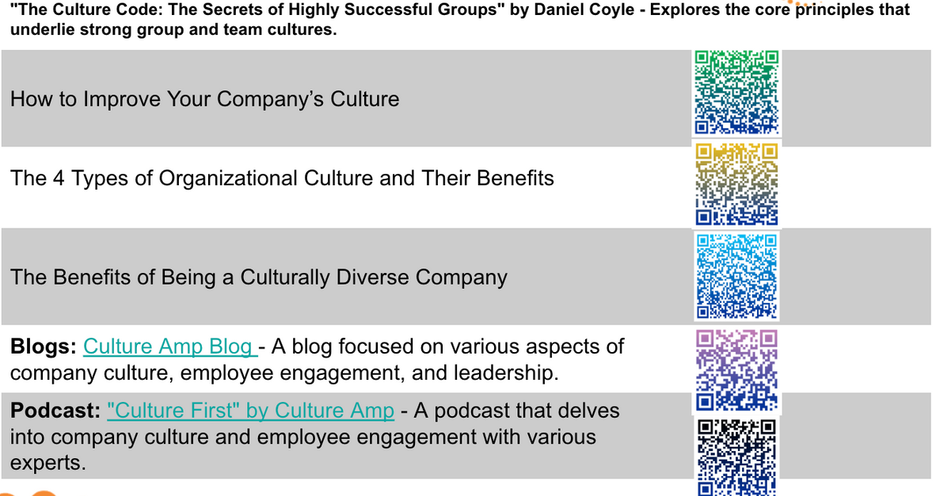
Additional readings
78
Notes:
78

Slide 82
Personal Branding
Leadership Module 3
79

Slide 83
Why is personal branding important?
In the dynamic world of entrepreneurship, personal branding serves as a powerful tool that transcends traditional marketing strategies. It has become indispensable for startup founders, offering a unique platform to convey their expertise, values, and vision.
For women entrepreneurs who often navigate the intricate balance of multiple roles in business and life, personal branding takes on an even more significant role. It not only facilitates the establishment of their business but also challenges gender biases and empowers them to be influential and successful leaders.
80

Slide 84
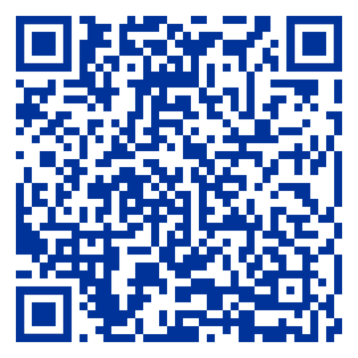
Personal branding: Video module
Scan the QR code to watch the video module on personal branding
<Insert video here>
81

Slide 85
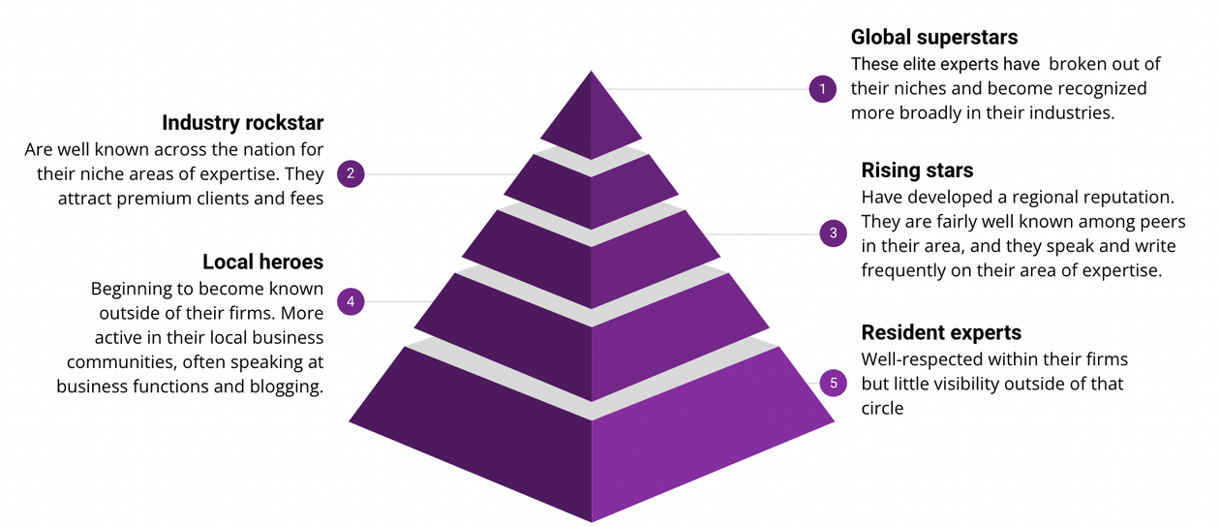
Pyramid of brand visibility
Ask yourself:
  What is your current visibility level?
  What level of visibility do you aspire to?
82

Slide 86
Personal brand toolkit
STRATEGY | PREPARATION
Identify your visibility goal | Revisit your socials
What is your area of expertise? | Work on your bio
Who is your audience? | Bring in the resources
What is your goal? | Invest in upskilling
Prepare your toolkit | Make it a habit
83

Slide 87
7 essentials to build your personal brand
  Speaking engagements
  A book
  A website
  A blog platform
  Email marketing service
  SEO
  Media kit
84

Slide 88
Tips to build a standout personal brand
  Share your personal experiences, challenges, and triumphs to create an emotional connection with your audience.
  Identify your unique skills and expertise, and center your brand message around them.
  Define your target audience and tailor your brand message to their specific needs and interests.
  Showcase your expertise through case studies, testimonials, and success stories.
  Create valuable content that encourages your audience to engage with you
  Establish a consistent content schedule and maintain it to keep your audience engaged and informed.
  7. Use data-driven insights to refine your tactics for better results
85

Slide 89
Reflection assignment
Read the following prompts and reflect on your own experience:
  Identify your personal values and beliefs. How do these values align with your personal brand and the image you want to project to the world?
  Define your purpose as a founder. What is the impact you want to make and the difference you aim to create in your industry or community?
  Determine what sets you apart from others in your industry. What unique skills, experiences, or qualities do you bring to the table?
86

Slide 90
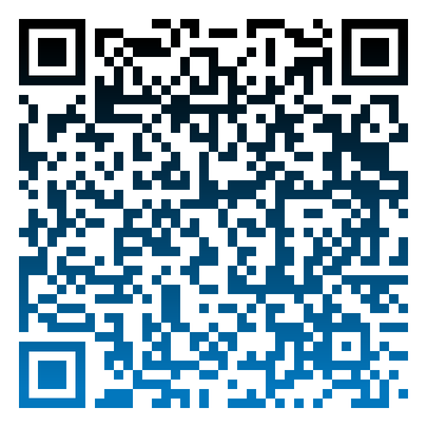
Reflection assignment
Scan the QR code to check out the reflections of the cohort:
87

Slide 91
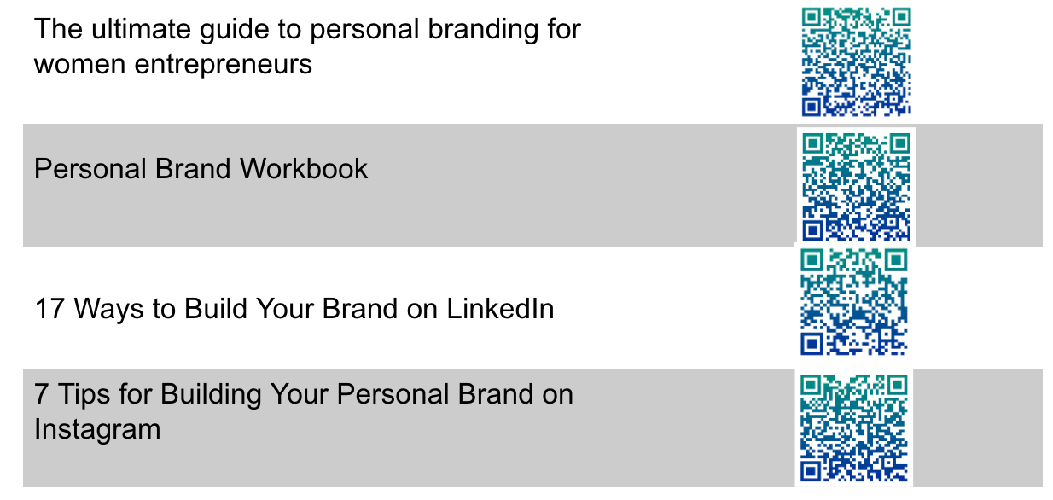
Additional readings
88
Notes:
88

Slide 92
Investment Readiness
Leadership Module 4
89

Slide 93
The basics of raising capital
What to keep in mind:
  Know why you need the money
  Are you expanding, developing a new product or covering operational costs?
  Understand what type of business you are
  Is it a high growth startup, a family enterprise or something in between?
  Decide what kind of business you want to build
  Basis your long term vision. This will influence your capital needs
  Determine the right kind of capital
  Loans, equity investments make sure it aligns with your business goals
The need for capital:
  You want to grow
  But your revenues are not allowing you to grow as fast as you want to/can
  You just don’t have the cash
  But you have customers/beneficiaries and see the potential
  You have recurring revenue
  And you are confident of repaying the funders
  You see opportunity
  Then bring on people who know the industry
90

Slide 94

Part 1: Understanding the basics: Video module
Scan the QR code to watch the video module on Understanding the basics of raising capital
<Insert video here>
91

Slide 95
Understanding types of capital
Do you need loans or grants?
  Does your enterprise have enough recurring revenue to repay loans?
  Can your model accommodate repayments?
  Do you need other forms like a credit line or grants?
Do you need Equity Capital?
  Not all enterprises need equity investment!
  Is your enterprise suited to receive venture capital?
  Are you ready to answer to investors?
  Are you set up legally to accept equity funding?
92

Slide 96
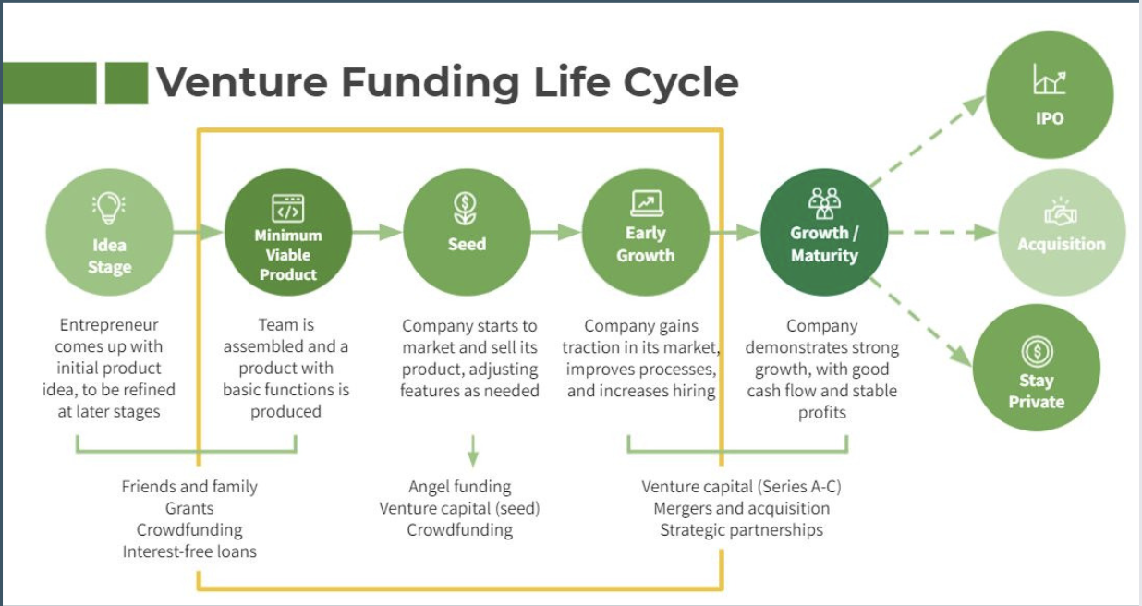
The venture funding lifecycle
93

Slide 97
Alternative sources of funding
  CSRs of corporate organisations
  Government
  Crowdfunding
  Active individual donors
  Global foundations
  Private foundations
  DFIs
94

Slide 98
Investment readiness checklist
  Have a validated business plan
  Know how much you need and why
  Calculate the value of your startup
  Exhaust all your other options
  Be ready to share your equity in your company
  Seek legal counsel
  Get your legal status and/or cap table in order
  Take into account the investor's personality
95

Slide 99
Key competencies of a startup
Team | Who is your founding team?
Problem & Vision | What problems are you solving for people?
Value Proposition | How will you uniquely solve this problem?
Product | Does your product or service demonstrate evidence of effectiveness?
Market | Who is your target market? Can you clearly identify your ideal customer?
Business Model | How will you make money?
Scale | Is there a clear path to scale..to markets?
Investor Exit | Is there a way for an investor to make money/get a return on their investment
96

Slide 100
What do Investors Look For?
  Potential to serve customers
  Long-term & sustainable profitability
  Lasting impact and contribution to SDGs
How Do Investors Look At Your Numbers?
  Consistent and good record of business compliance
  Sound financials (bookkeeping & projections)
  Consistent growth in sales
  Sound unit economics/good margins
  Forward thinking founders with long term goals and prospective clients
  Sound and strategic budget plan
How Do Investors Look At Your Impact?
  Impact strategy integrated into business model
  Number of individuals and communities impacted
  Impact framework and/or policies in operations
  Evidence of impact through metrics
97

Slide 101
Getting Investment Ready
  Your Growth Plan
  Your Ask - How Much & What Type, Use of Capital
  Key Materials & Data Room
  Pitch Deck
  Financials - Audited FS, 5-yr Financial Projections, Cashflow
  Valuation (If raising equity)
  Data Room - Additional Key Documents:
  Sales pipeline, Proof of sales/PO, Org Chart, Key Contracts, Cap Table
<Insert video here>
98

Slide 102
Reflection Assignment
Read the following prompt and reflect on your own experience:
  Identify what type of capital is appropriate for your business and the stage you are in.
99

Slide 103
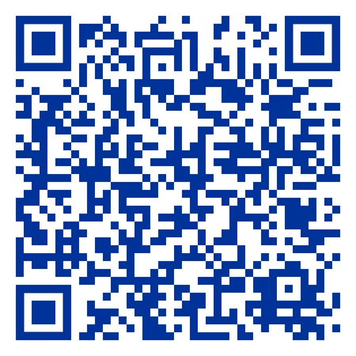
Part 2: Facing the odds: Video module
Scan the QR code to watch the video module on Facing the odds
<Insert video here>
100

Slide 104
Key Challenges
  Barriers in accessing networks
  Women are typically cut off from appropriate networks
  Systemic Biases
  Men and women entrepreneurs are treated differently
  Negotiation Challenges
  Women in many cases feel they are not equipped for tough investor negotiations
101

Slide 105
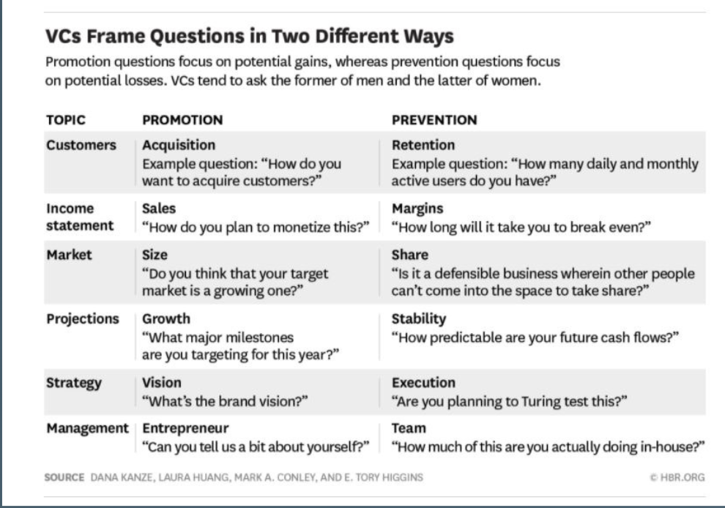
Biases Can Show Up
102

Slide 106
Essentials for Investment Readiness
  Showup with confidence: prep with questions
  Present a clear vision: Draft a well articulated business plan
  Be your passionate self: stay authentic and true to yourself
  Demonstrate awareness of alignment with decision makers
Prepare.Practise.Pitch
  Know your ask
  Calculate & present a clear valuation
  Create 5 year projections or plans
  Prepare key metrics
Get your financials ready
  Understand the basic terms of investment
  Know your desired and lowest acceptable terms
  Run scenarios with a mentor or a friend
  Do not accept anything that you do not understand
Get trained on negotiations
  Who do you know in business or impact leadership
  Have your friends mentioned any influencers who they can connect you to?
  Do you know any entrepreneurs who raised funding?
  Do you know anyone in the VC space?
Expand your networks
103
Notes:
103

Slide 107
Useful Tips
  BE BOLD. BE AUTHENTIC. BE YOURSELF.
  Once you prep, practice with someone who can give you tips to refine your pitch.
  Align with a gender lens: Don't be afraid to write to people. Find investors and funders that support women-lead enterprises. Use the cards you have.
  Build a Data Room: Put together a easy to access folder with key documents for investors.
  Articulate Your Numbers Well: Have data backed answers to your assumptions.
  Be Real but Ambitious: Have clarity on what you can and want to achieve.
  Answer with a positive spin & showcase success.
  Prepare key stories that highlight your potential.
  Know your lowest acceptance and be ready to walk away.
104

Slide 108

Reflection Assignment
Read the following prompts and reflect on your own experience:
  What is my unique value proposition as a founder?
  How can I leverage my unique perspective and experiences as a woman entrepreneur to my advantage when it comes to raising capital for my enterprise?
  Scan the QR code to check the pitch deck
  guidelines
105

Slide 109
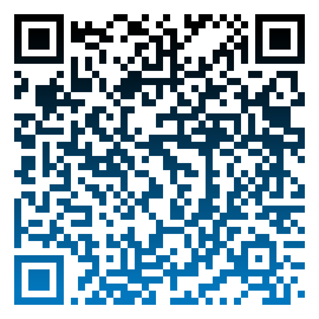
Reflection assignment
Scan the QR code to check out the reflections of the cohort:
106

Slide 110
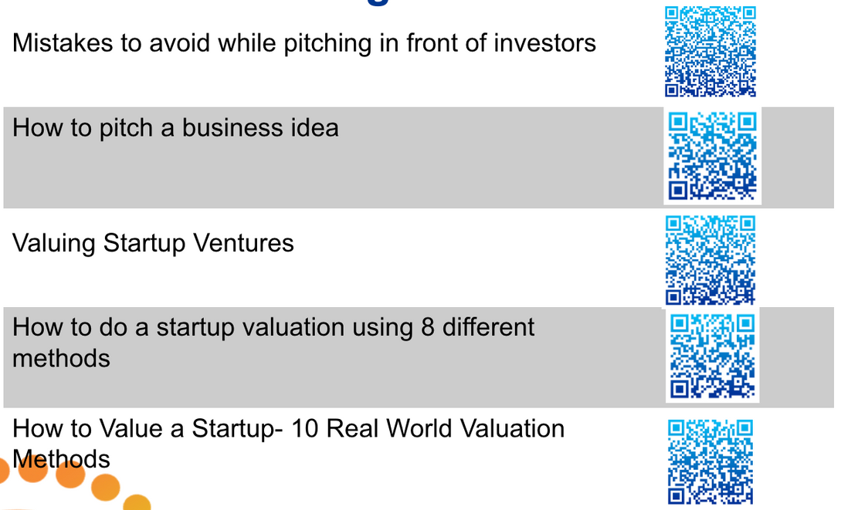
Additional Readings
107
Notes:
107

Slide 111
Leadership Circle
108

Slide 112
Objectives of the Leadership Circle
Entrepreneurship can be a lonely journey and there are challenges we face as leaders that hinder our path to personal and professional growth. In these scenarios it helps to discuss these challenges with peers, who are also startup entrepreneurs and going through similar journeys, and can therefore share insights and feedback that could potentially help us in with our own experiences and challenges
  Participants to discuss leadership challenges with their peer group in order to learn from each others’ experiences and take back practical insights and tips
  This will also create an atmosphere of peer support and openness to learning, breaking the barriers around entrepreneur loneliness
109

Slide 113
What is a Leadership Challenge?
Leadership challenges refer to the common issues leaders and founders must face as part of their role. These can take many forms, from dealing with budgets to keeping employees motivated. By being aware of these challenges and preparing ways to overcome them, a leader can focus on those they lead and their goals.
External Challenges
External leadership challenges derive from outside sources such as:
  Insufficient resources
  Shortage of funding
  Employee objection and resistance
  Social issues among employees inside the company
  Internal Challenges
  Internal challenges are difficulties a leader may face that include:
        Fear
        Lack of self-confidence
        Impatience
110

Slide 114
Sharing a Leadership Challenge
Reflect on the following questions and make notes to share with your leadership circle group:
  Identify a leadership challenge you are currently facing in your organisation?
  What measures have you taken to overcome this challenge?
  What areas are you looking for feedback on?
  Post discussion, make notes on what you will do differently to address your leadership challenge:
  What will you stop doing? b) What will you start doing?
111

Slide 115
Leadership Circle format
Leadership Circles work best in groups of 3-6 people as it allows for more in-depth discussions. For best results, the group can continue to engage in this sharing circle even post the event on their own schedules and times.
  Each participant will have 30 minutes to discuss their leadership challenge with the group in the following format
  5 min: present your leadership challenge previously noted down in the format provided (the rest of the group must remain silent at this time)
  5 min: The group asks clarifying questions about the challenge which the presenter will provide (this is NOT the time for solutions)
  15 min: The group discusses the challenge put forth by the presenter among each other and offers feedback and solutions to the problem
  Note: The presenter must ONLY listen at this point and take notes
  5 min: The presenter responds to the discussion and also tells the group
  what they will stop doing and b) start doing to address the problem
  Note: Each group must have a timekeeper. Each participant must stick to the allotted time
112

Slide 116
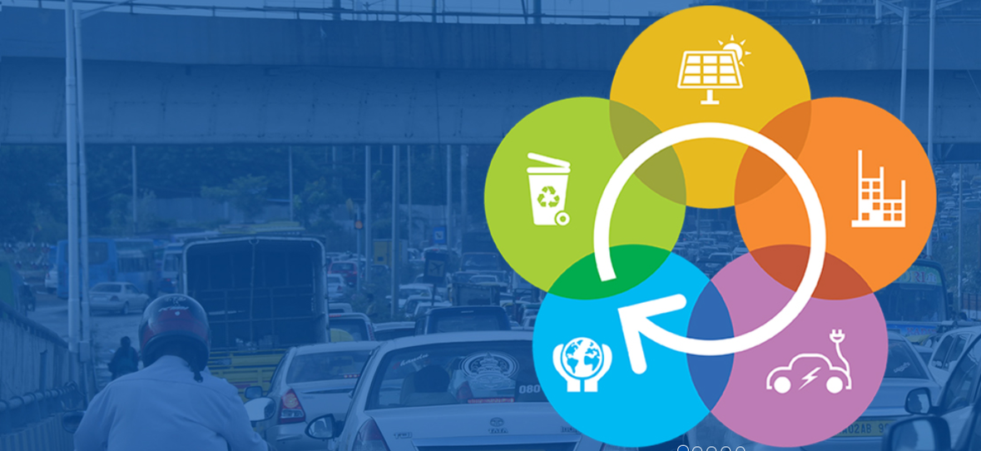
This has been produced with the assistance of the European Union. The contents of this publication are the sole responsibility of the author and can in no way be taken to reflect the views of the European Union or the EU Delegation.
THANK YOU
www.eu-rei.com
113

